Slide 1
Metadata Standards and
XML Technologies for
Unlocking Statistical Data
Pascal Heus
Metadata Technology / Open Data Foundation
pascal.heus@metadatatechnology.com

Slide 2
Context
Domain: socio-economic data, health data, official statistics, and the likes
Kind of data: both microdata (datasets) and macrodata (aggregated statistics / time series)
Produced by: government/federal agencies (data.gov), national statistical offices, international organizations, researchers
Consumed by: producers, policy/decision makers, academic researchers, economists, public agencies, private sector, press, other users
but can be used in other domains
Notes:
Microdata examples: surveys (household, farms, enterprises), censuses (population agriculture) typically used with statistical packages. Can be sensitive.
Macrodata examples: monthly employment, currency exchanges, literacy, . Typically public domain (but not necessarily)

Slide 3
Challenges
Discovery / Access / Exchange
Data Quality / Usefulness
Data Documentation
Harmonization / Comparability
Preservation
Data production
Data privacy vs. openness, transparency
…in world of legacy systems, proprietary software, traditional practices…
Notes:
Documentation:
- Contextual metadat required for resuefulness, generator

Slide 4
Is there a magic bullet?
Some of these have been seen before…
The rise of the Internet, business to business, business to consumer, communities, social networks, etc.
Solved through XML technologies, web service oriented architecture, adoption of standards models, web 2.0
Same industry standards strategies can be used for managing microdata and official statistics
The past decade has focused on development of domain specific standard and tools by key stakeholders
But we need more than one bullet…
Data Documentation Initiative (DDI)
Statistical Data Metadata Exchange standard (SDMX)
Complementing standards: ISO 11179, ISO 19115, Dublin Core, METS, …

Slide 5
Data Documentation Initiative (DDI)
Originates in data archiving community
For microdata or low level administrative statistics
Data typically in SAS, Stata, SPSS, R, ASCII, SQL, …
DDI-Codebook (1.x-2.x):
Fit for preservation/archive, single survey, after the fact documentation, stand alone agency
Simple to use, in existence for over a decade
Widely adopted, tools/training available
DDI-LifeCycle (3.x):
Fit for managing data and metadata across production/archive/dissemination/research
Published in 2006, encourage reuse and robust design
Ongoing rapid adoption, tools/training becoming available

Slide 6
Statistical Data and Metadata Exchange Standard (SDMX)
Initiative from international organizations
BIS, ECB, EUROSTAT, IMF, OECD, UN, World Bank
Need for global data exchange framework
Is an ISO standard (17369)
Use for aggregated statistics / time series
Typically used in excel (analyst), HTML (casual web user), data warehouse (analytics)
SDMX describes information (structure) but also natively carries data
Publication of static data for exchange between organization or access by end users
Recognized in 2007 by UN statistical commission as the preferred standard for the exchange and sharing of data and metadata

Slide 7
DDI + SDMX
Leverage proven industry standard technologies
XML, XSchema, XSL/Xpath/XQuery, SOA
Cost effective implementation / integration
Human readable and machine actionable
Are complementing standards / work hand-in-hand
Designed for different use cases / needs
But together, cover the entire data lifecycle, from respondent to policy maker
Broad Adoption
Internationally recognized, widely used, large community
Face little or no competition
Designed to work with other standards
ISO 11179, ISO 19115, Dublin Core, RDF, …

Slide 8
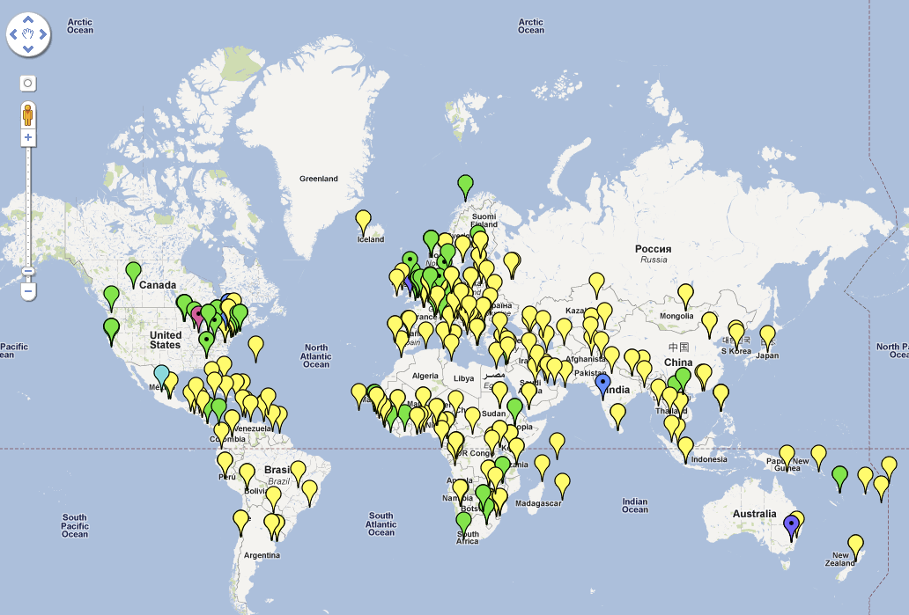
DDI / SDMX Map (draft)
http://goo.gl/73mfd
Courtesy of Australian Bureau of Statistics

Slide 9
Selected success stories
International Household Survey Network
Rolled out DDI in developing countries around the globe
Hundreds of surveys now documented, often with underlying data available over the web
See http://ihsn.org/adp/index.php?q=country-activities
Social Science Data archives
Across Europe, North America, Australia, using DDI to capture and publish information on large data collections
Thousands of surveys documented
Examples
http://www.cessda.org/accessing/catalogue/
http://nesstar.assda.edu.au/webview/index.jsp
http://www.openmetadata.org
Etc.

Slide 10
Selected success stories
Interuniversity Consortium for Political and Social Research (ICPSR)
An international consortium of about 700 academic institutions and research organizations provides access to over ½ million data files captures DDI metadata for over 7000 surveys (and is also the birth place of DDI)
http://www.icpsr.umich.edu/icpsrweb/ICPSR/or/metadata/xml/index.jsp

Slide 11
Selected success stories
European Central Bank
Demonstrating saving 120 FTEs per year by basing their systems on the SDMX model
http://sdmx.org/docs/2007/Conf07/doc%2004%20ECB.ppt
Federal Reserve Board of NY
Doubled their hit-rate on the website when they exposed what had been CSV files in an SDMX format
http://sdmx.org/docs/2007/Conf07/doc%2015%20NewYorkFed.ppt
Joint External Debt web site
Turned a 3-month production process into minutes by adopting SDMX
http://www.jedh.org/

Slide 12
Ongoing efforts
Numerous projects are under way leveraging DDI and SDMX.
Australian Bureau of Statistics
Implementing a SDMX+DDI framework
Canada Research Data Center Network
DDI-LifeCycle driven data/metadata management framework
Data without Boundaries
Integrated model for accessing official data in Europe
27 partners from 12 European countries
Tools
Open source and commercial software are becoming increasingly available
IHSN Toolkit, Nesstar, CRDCN project, OECD.Stat, Algenta Colectica, Stat/Transfer, Space Time Research, etc.

Slide 13
What’s the catch?
Not only a technology challenge (that's the easy part) but also need:
Infrastructure, Tools, Training
Awareness & adoption (need success stories)
Models are complex (but compliance is all that is needed)
Managing the change
Integration in day-to-day environment
Upper level management / funding agencies need to drive adoption
Show benefits and return on investment
Broad adoption for full benefits
By producers, archives, researchers, vendors

Slide 14
Open Data Warning
This is not only for public data!
Information is about individuals, corporate entities
this is not data in the “Internet” sense
Transparency is important but access must be in accordance with UN fundamental statistical principles, legal systems, and respect respondent privacy
This is often misunderstood or overlooked
Broad definition of “open data”
Accessible, fit or use, safe and secure, meet needs of producer and end-users, well documented
Can be protected / non-public data
Comprehensive metadata are essential to responsibly and effectively providing access to all data
Notes:
UN: http://unstats.un.org/unsd/dnss/gp/fundprinciples.aspx
US
CIPSEA: http://en.wikipedia.org/wiki/Confidential_Information_Protection_and_Statistical_Efficiency_Act
CENSUS: Title 13
Fit for use and purpose: consistent, coherent, exhaustive, timely, relevant, and providing the answers to real questions
- Accessible: can be discovered, accessed, and understood
- Safe and secure: physical access to the actual data is controlled
and respondents are protected in accordance with statistical
principles and laws
- Well documented: data is accompanied by high-quality metadata that satisfies casual users, researchers and producers. It captures sufficient informa- tion to replicate the work (replication standard) and is based on accepted standards of quality and completeness.

Slide 15
The data.gov use case
Several data.gov like initiatives (us, uk, nz, ca, …)
All are attempting to bring together data from numerous sources could significantly benefit from structured metadata standards such as DDI/SDMX
The US data.gov
Extra-challenge: US federal statistical system is composed of over 120+ statistical agencies (no national statistics office!), and state level agencies…
This is a perfect use case for DDI and SDMX
Recommendations
Consider adopting DDI / SDMX and related standards across statistical system (don’t make up new ones!)
Advocate and support the use by federal agencies of industry standard XML and SOA IT architecture

Slide 16
Summary
Domain specific mature metadata specifications are available for managing socio-economic data, health data, and official statistics
The Data Documentation Initiative (DDI) is the recommended specification for “microdata”
The Statistical Data Exchange Standard (SDMX) is the recommended standard for aggregated data / time series
Both leverage IT industry standard technologies
These standards are seeing broad adoption around the globe and can benefit numerous organizations and individuals
We need to encourage adoption by key agencies and stakeholders
And can also be applicable to other domains

Slide 17
Thank you!
Announcements
The IASSIST 2012 conference will be held at GWU in Washington, DC June 6-8 (http://www.iassistdata.org)
New DDI/SDMX community portal to launch next year (signup at http://www.openmetadata.org)
Contact us for ODaF membership or join LinkedIn group
For more information
http://www.ddialliance.org
http://www.sdmx.org
http://www.odaf.org
http://www.iassistdata.org
http://www1.unece.org/stat/platform/display/metis/METIS-wiki
http://www.metadatatechnology.com
Contact
pascal.heus@metadatatechnology,com

Slide 18
References
"The Data Documentation Initiative (DDI): An Introduction for National Statistical Institutes", Arofan Gregory, Open Data Foundation, Jul 2011, http://odaf.org/papers/DDI_Intro_forNSIs.pdf
"Open Data and Metadata Standards: Should We Be Satisfied with 'Good Enough'?", Arofan Gregory, Open Data Foundation, Jun 2011, http://odaf.org/papers/Open%20Data%20and%20Metadata%20Standards.pdf
“Maximizing the Potential of Data: Modern IT Tools, Best Practices, and Metadata Standards for SBE Sciences”, Pascal Heus (Metadata Technology North America Inc.), Arofan Gregory (Open Data Foundation), Oct 2010 http://www.nsf.gov/sbe/sbe_2020/submission_detail.cfm?upld_id=268
"Metadata", Arofan Gregory (ODaF), Pascal Heus (ODaF), German Council for Social and Economic Data Working Paper no. 57/2009, March 2009, http://www.ratswd.de/download/workingpapers2009/57_09.pdf
“DDI and SDMX: Complementary, Not Competing, Standards", A. Gregory, P. Heus, Open Data Foundation, July 2007
“Combining Metadata Standards: Approaches and benefits”, Arofan Gregory, Open Data Foundation, Work Session on Statistical Metadata (METIS) (Geneva, Switzerland, 10-12 March 2010), http://www.unece.org/stats/documents/ece/ces/ge.40/2010/wp.3.e.pdf
"Data Documentation Initiative: Toward a Standard for the Social Sciences", Mary Vardigan (ICPSR), Pascal Heus (ODaF), Wendy Thomas (MPC), International Journal of Digital Curation, Vol 3, No 1, Aug 2008, http://www.ijdc.net/index.php/ijdc/article/view/66

