Slide 2
About Thomson Reuters
At $13B in 2009 revenue, we are the leading source of intelligent information for the world’s businesses and professionals, providing customers with competitive advantage
Markets Division
Professional Division
Legal
legal, intellectual property (IP), compliance, business and government professionals
Sales &
Trading
buy-side and sell-side customers in the foreign exchange, fixed income, equities and other exchange-traded instruments, and commodities and energy markets
Tax & Accounting
accounting, tax and corporate finance professionals in accounting firms, law firms, corporations and government agencies
Investment &
Advisory
portfolio managers, wealth managers, investment bankers,
research analysts and corporate executives
Healthcare & Science
doctors, hospitals, scientists, researchers and academics
Enterprise
financial markets
Media
newspapers, television and cable networks, radio
stations and websites
Notes:
To better understand the massive quantity of data we help make sense of daily for the customers and millions of lives they impact, here’s a high level overview of our business.
Thomson Reuters delivers information to customers through offices in more than 300 cities in more than 100 countries.
We deliver critical information to leading decision makers in the financial, legal, tax and accounting, healthcare and science and media markets, powered by the world's most trusted news organization.
The scale of customers are vast across each business division as is the data to support them.

Slide 3
About Thomson Reuters: Scale of data
How we manage data is critical to our business of delivering information to customers
In our Healthcare & Science and Tax & Accounting businesses alone, we manage 1.5 petabytes of data
Our Open Calais service, the public version of the Calais service, processes more than five million documents per day
In our Markets Content group, the data we hold on some 50,000 active companies represents over 95% of the world’s market value. The data cache rivals the 20 million books of the U.S. Library of Congress - in digital format
Our Professional Shared Technology Services manages about 11 petabytes of storage across their data centers globally
The storage capacity of our Markets Content, Technology & Operations data centers is four petabytes equivalent to 1 million DVDs or more than twice the size of all libraries in the US

Slide 9
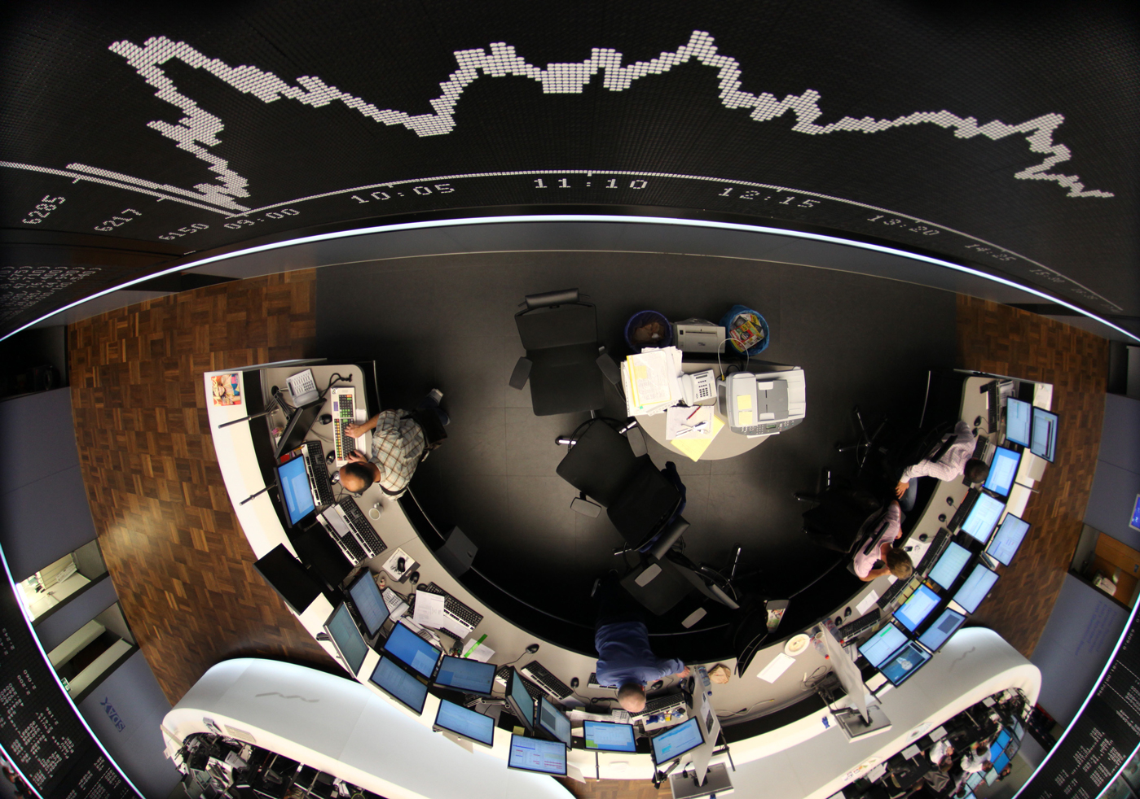

Slide 10
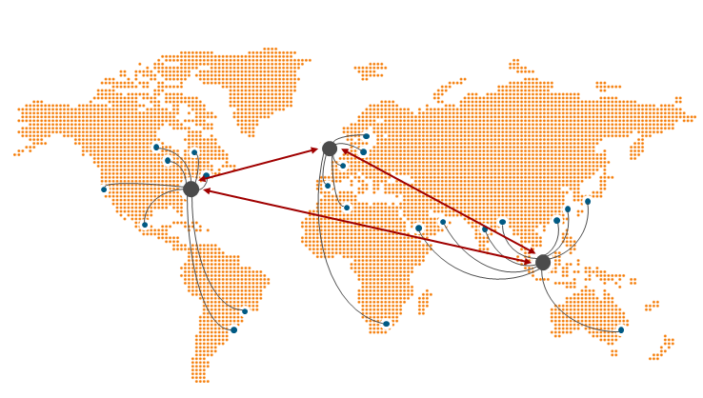

Slide 11
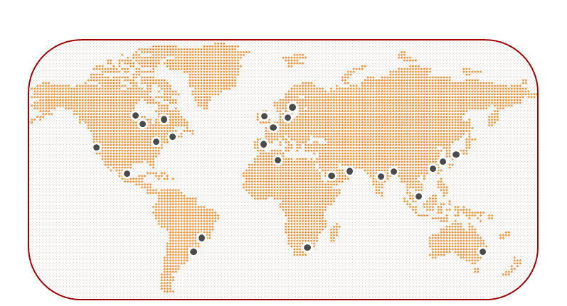

Slide 12
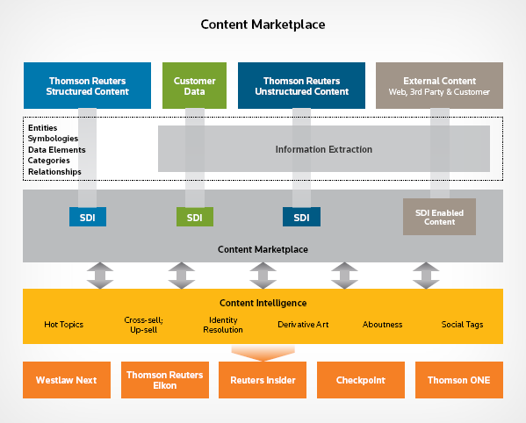

Slide 13
Best search engine for law
Community insights
Optimized research workflow
BIG SUCCESS Attorneys complete research 64% faster!

Slide 14
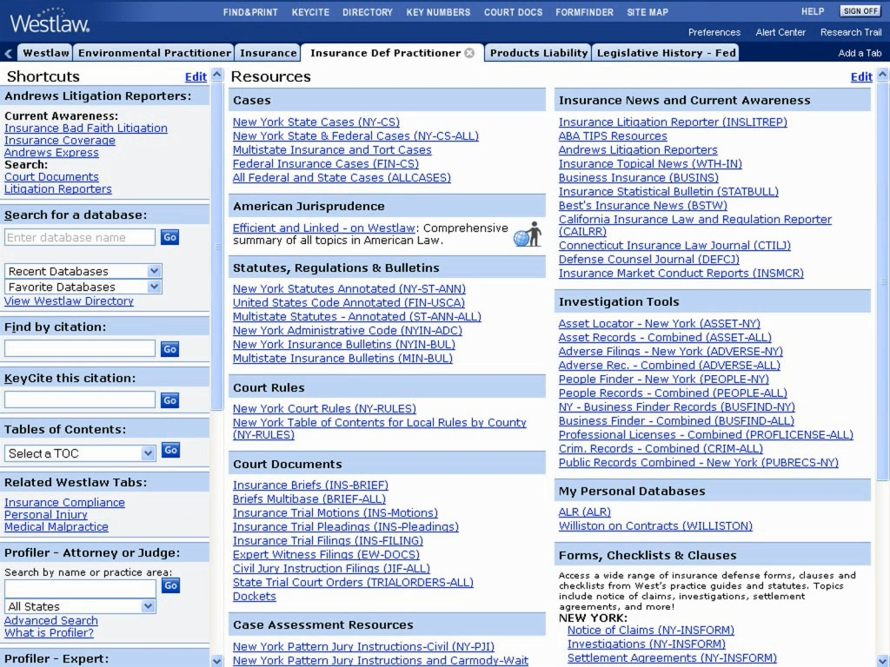
Notes:
Previous version of Westlaw – 40,000 databases, and you must figure out which one has your answer before running a search

Slide 15
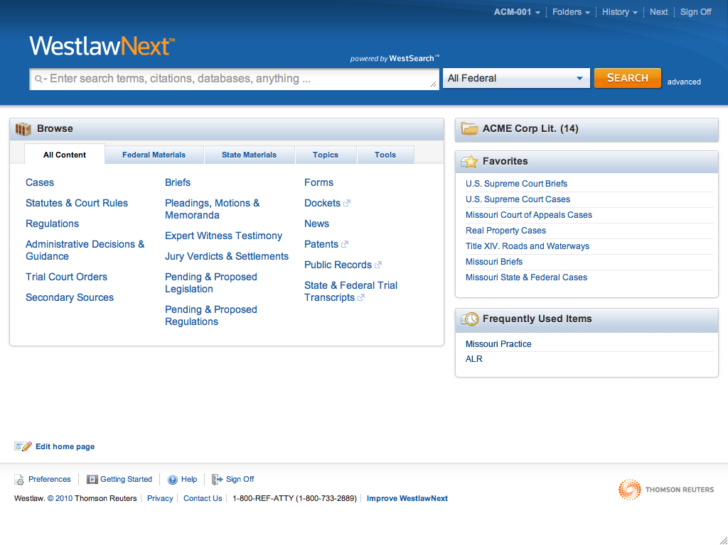
Notes:
With our new version, WestlawNext, the researcher just chooses a jurisdiction, like NY, or All Federal (or all jurisdictions if she wants), and we deliver everything that is relevant…

Slide 16
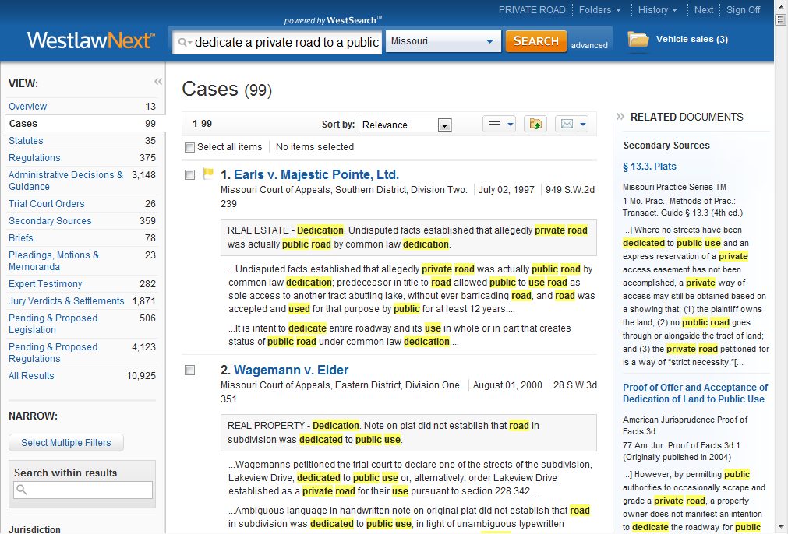
Notes:
Now all relevant documents listed on the left by type, with new ways to filter and sort

Slide 17
Notes:
Beyond simplifying the user experience in terms of database selection, the biggest change is how the engine works behind the scenes.
Previous version of Westlaw had a literal search engine – just looked for documents that had your precise word.
However, there are many cases in NJ that are about whistleblower law but don’t use the term whistleblower
Also, there are many cases that make a passing reference to a whistleblower issue but aren’t really about that.

Slide 18
Notes:
The new version of Westlaw, WestlawNext, leverages relationships between documents to move beyond literal terminology to deliver what is needed.
In NJ, the state’s whistleblower statute is called the Conscientious Employee Protection Act and never uses the term whistleblower at all. WestlawNext makes the connection between what the user asks for and what the user wants.

Slide 19
Notes:
The result of this is dramatic. We tested 5 legal research problems with 100 attorneys, and those who used WLN completed the problems almost 3 times faster (64% faster).

Slide 20
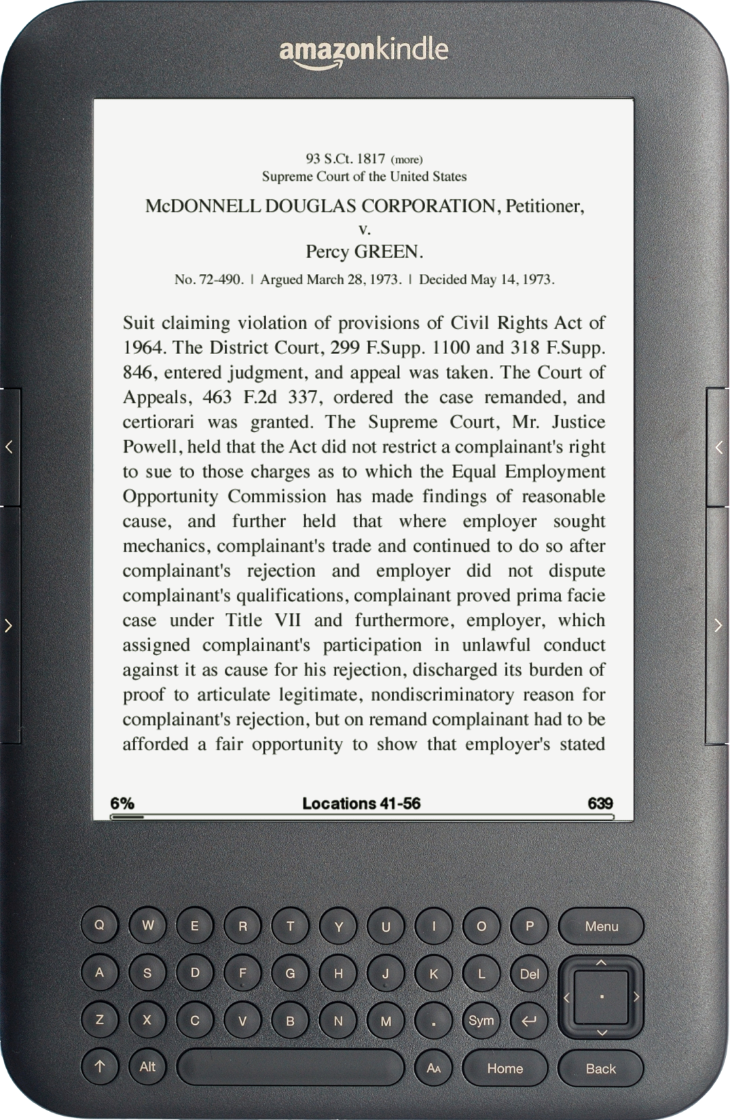
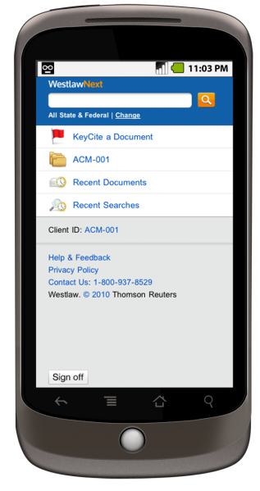
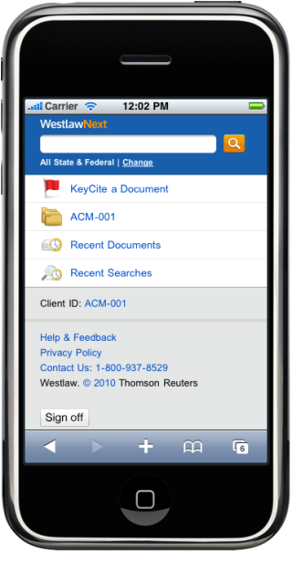
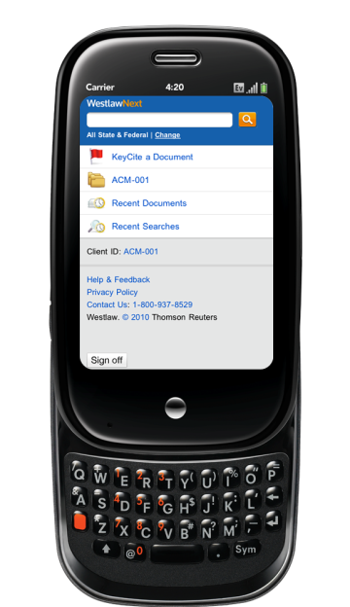
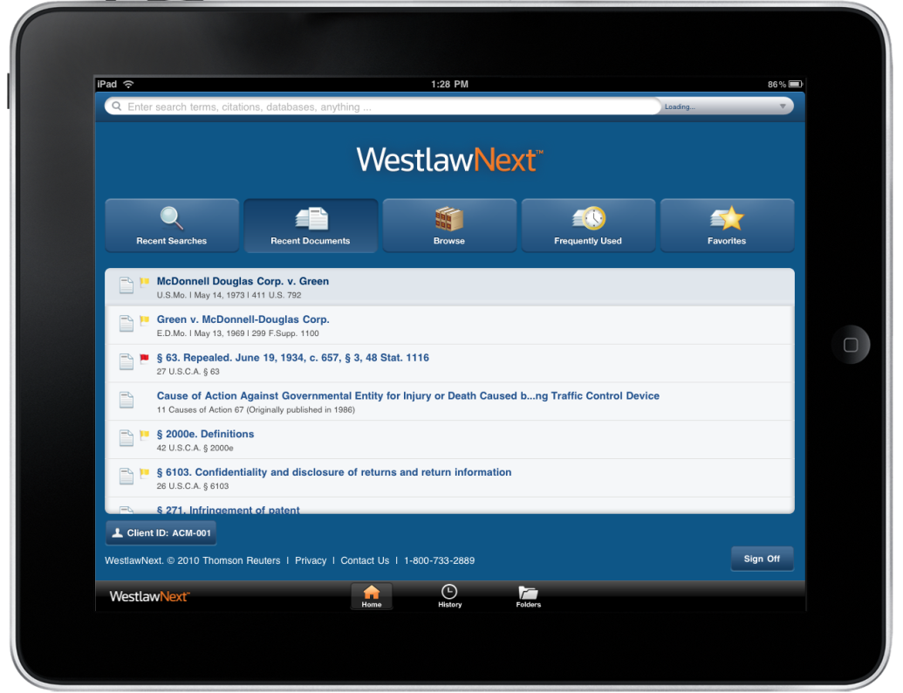
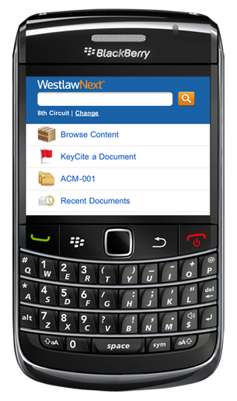
WestlawNext is available on any device
Notes:
One big change from a decade ago is that we now have to have these great, super-fast experiences available wherever our customers are, so we’ve optimized the legal research and reading experience for smart phones, eReaders, and tablet devices.

Slide 22
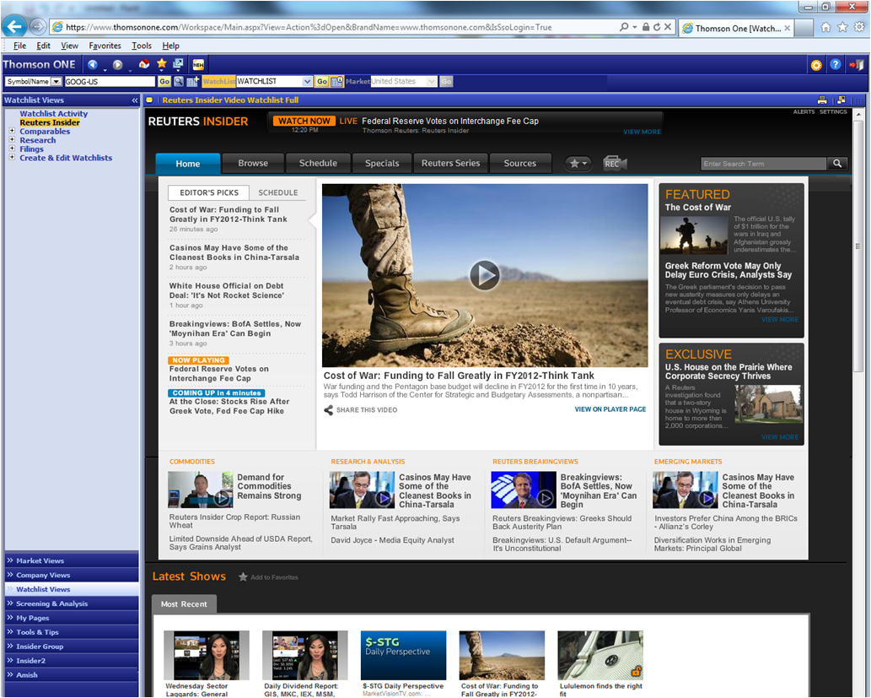

Slide 23
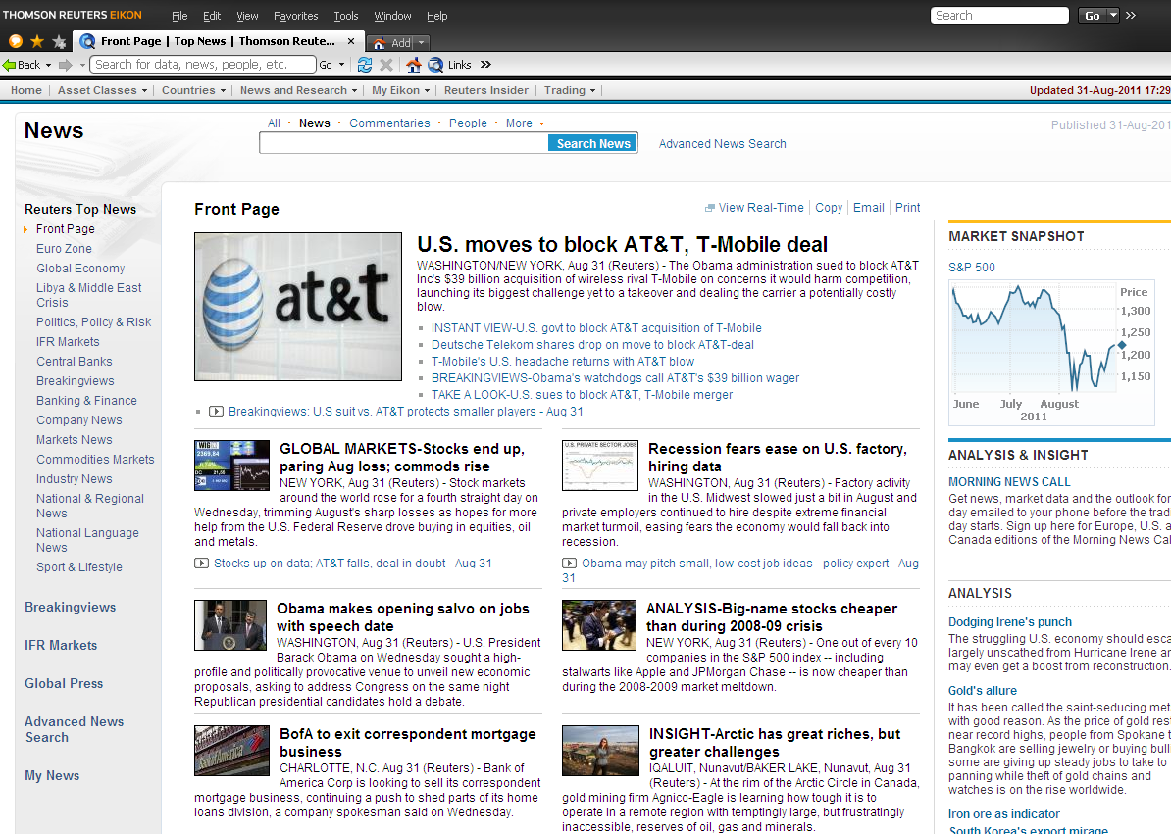

Slide 24
