Slide 1
Building and Learning from Social Networks
Chris McConnell
Future Social Experiences (FUSE) Labs
Microsoft Research

Slide 2
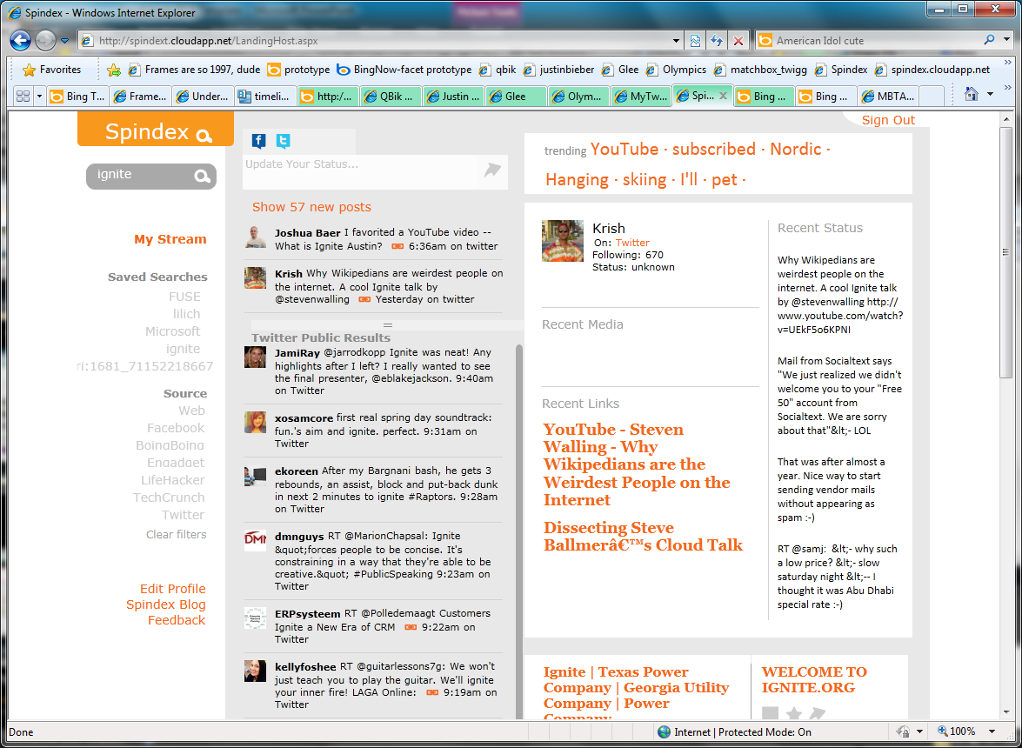
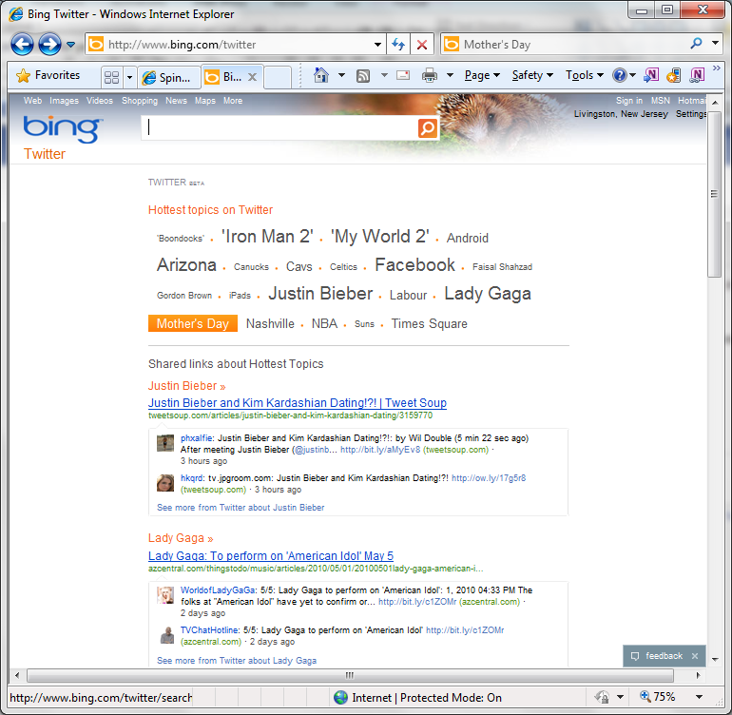
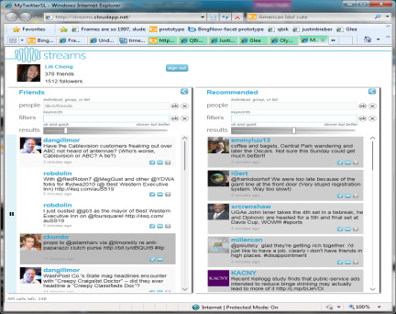
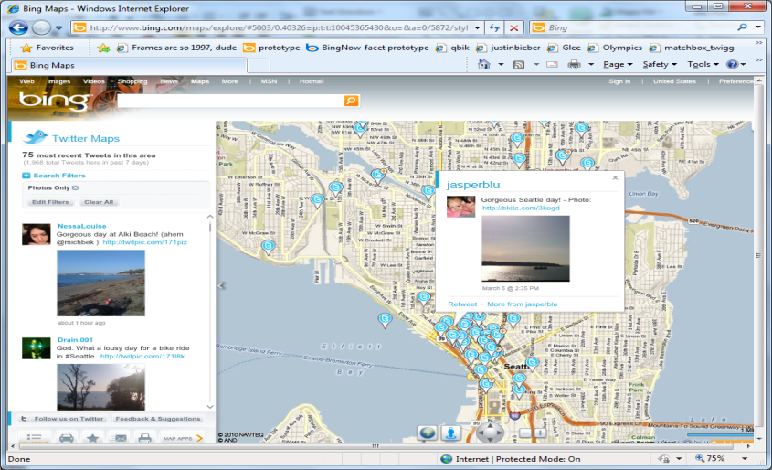
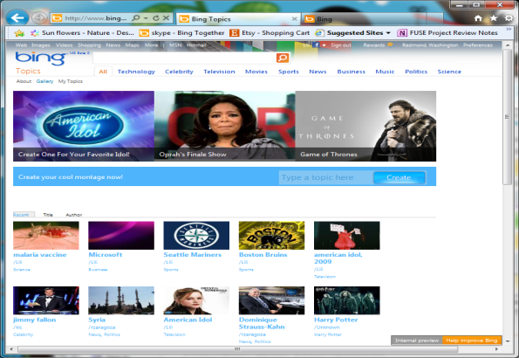
Notes:
10 years of building and studying social networks
Release real experiences often and get feedback

Slide 3
Current Research Areas
Analyzing Large Scale Social Data
Social Media and Hyper-local Community Engagement
Lightweight Social Curation and Online Sharing
Interest Networks

Slide 4
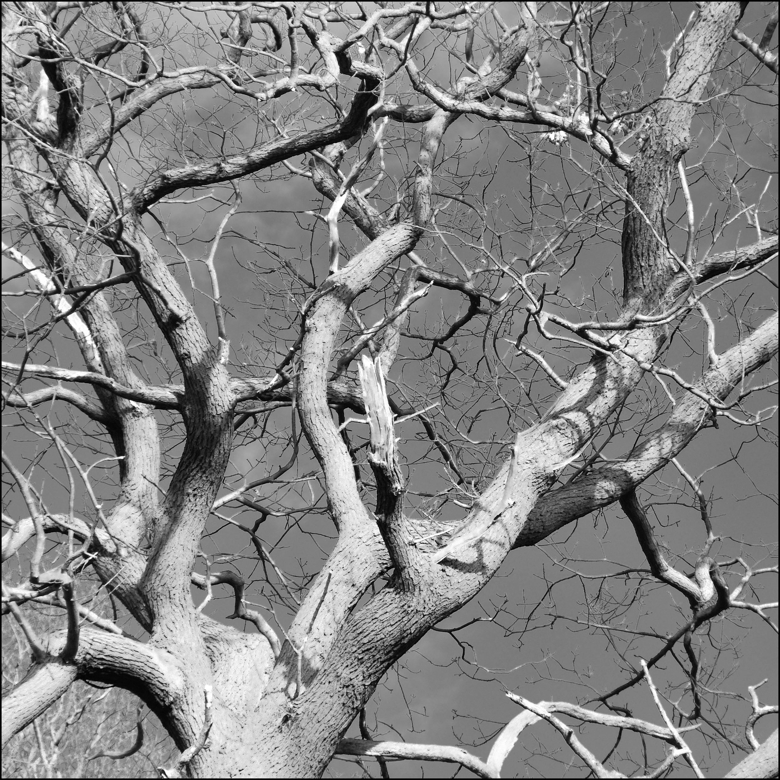

Twigg

Slide 5
Real-time Social Data
August 2009: Twitter data: Public status messages
  12 million updates a day (20x our estimates)
  Massive growth every month
September 2012: Twitter data + Facebook public data
  25,000 updates / second
  2.1 billion updates / day
2 guys + Windows Azure + Bing

Slide 6
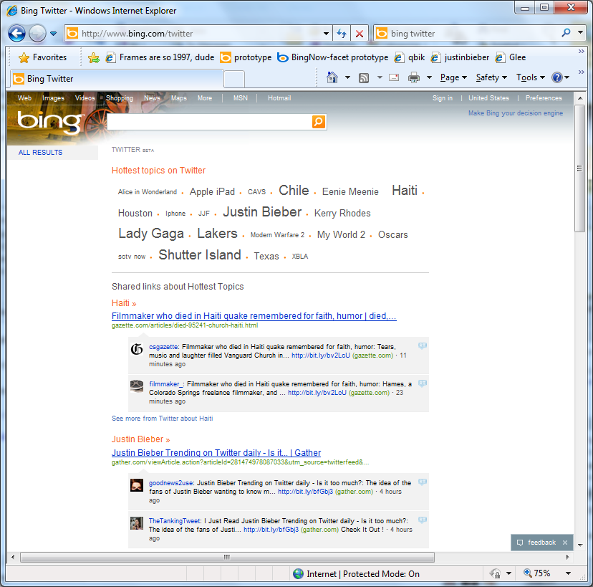
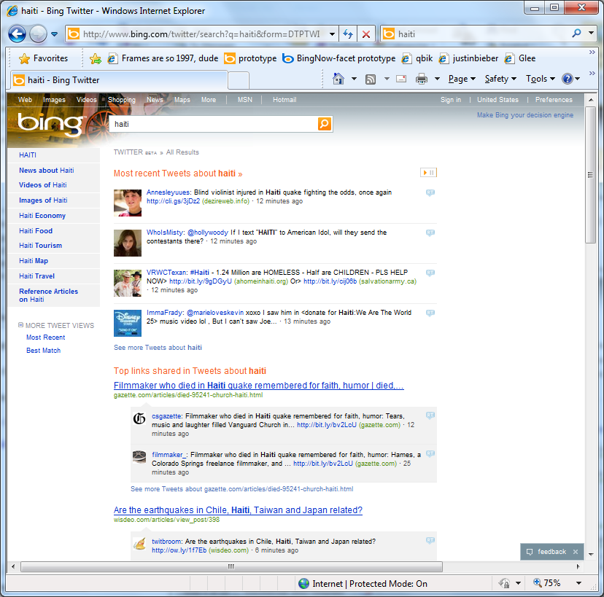
Social Search
Bing Now
  Twitter
  Facebook
Bing Answers
Indexing URLs
….

Slide 7
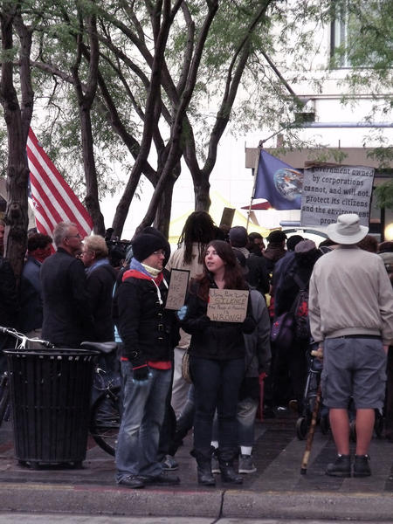
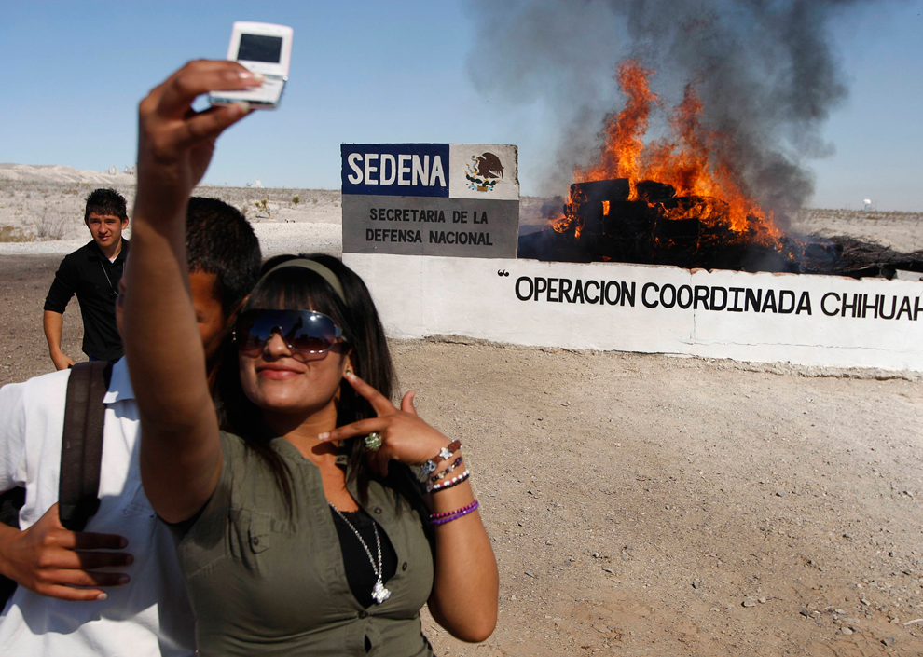
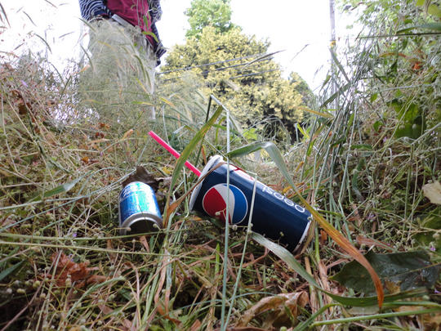
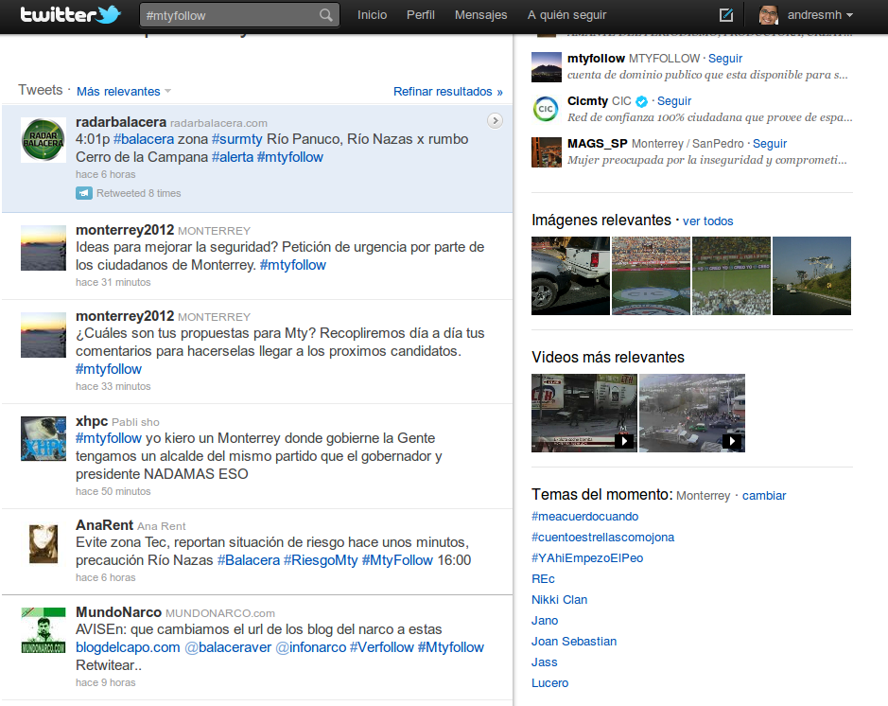
Mobility & Location: Project Monterrey
Hyper-local social media for improved civic engagement & collective action
Monterrey, Mexico Seattle, WA
Beacon Hill Litter, by Pit Bull Vicious
http://pugetsoundoff.org/image/20909

Slide 8
Current Seattle Twitter Data
6% of all messages mention Seattle/Seattle area
City | Neighborhood | Nested Neighbood |  | Count
Seattle |  |  |  | 63588
Seattle | Ballard |  |  | 1241
Seattle | Ballard | Adams* |  | 1118
Seattle | Ballard | Loyal Heights |  | 6
Seattle | Ballard | Sunset Hill |  | 7
Seattle | Ballard | West Woodland |  | 2
Seattle | Ballard | Whittier Heights |  | 8
Seattle | Beacon Hill |  |  | 99
Seattle | Beacon Hill | Holly Park |  | 8
Seattle | Bitter Lake |  |  | 2
Seattle | Broadview |  |  | 11
Seattle | Bryant |  |  | 401
Seattle | Capitol Hill |  |  | 1008
Seattle | Capitol Hill | Broadway |  | 634
Seattle | Capitol Hill | Madison Park |  | 44
Seattle | Capitol Hill | Montlake |  | 144
Seattle | Capitol Hill | Portage Bay |  | 42
Seattle | Capitol Hill | Stevens* |  | 614
Seattle | Cascade* |  |  | 245
Seattle | Cascade | Westlake* |  | 3198
Seattle | Cascade | South Lake Union |  | 122
Seattle | Central Area |  |  | 3
Seattle | Central Area | Atlantic* |  | 373
Seattle | Central Area | Denny-Blaine |  | 0
Seattle | Central Area | Leschi |  | 30
Seattle | Central Area | Mann* |  | 2936
Seattle | Central Area | Minor* |  | 543
Seattle | Crown Hill |  |  | 18
Seattle | Delridge |  |  | 90
Seattle | Delridge | High Point |  | 13
Seattle | Delridge | Highland Park |  | 15
Seattle | Delridge | Riverview |  | 3
Seattle | Delridge | Roxhill |  | 22
Seattle | Downtown |  |  | 2008
Seattle | Downtown | Belltown |  | 423
Seattle | Downtown | Central Business District |  | 4
Seattle | Downtown | Central Waterfront |  | 196
Seattle | Downtown | Denny Regrade |  | 347
Seattle | Downtown | First Hill |  | 70
Seattle | Downtown | International District |  | 35
Seattle | Downtown | Pike Market |  | 34
Seattle | Downtown | Pioneer Square |  | 180
Seattle | Downtown | Yesler Terrace |  | 48
Seattle | Fremont |  |  | 713
Seattle | Georgetown |  |  | 167
Seattle | Green Lake |  |  | 525
Seattle | Greenwood |  |  | 255
Seattle | High Point |  |  | 32
Seattle | Industrial District |  |  | 0
Seattle | Industrial District | Harbor Island |  | 0
Seattle | Interbay |  |  | 46
Seattle | Lake City |  |  | 222
Seattle | Lake City | Cedar Park |  | 1
Seattle | Lake City | Matthews Beach |  | 0
Seattle | Lake City | Meadowbrook |  | 7
Seattle | Lake City | Olympic Hills |  | 1
Seattle | Lake City | Victory Heights |  | 0
Seattle | Laurelhurst |  |  | 11
Seattle | Madrona |  |  | 70
Seattle | Magnolia |  |  | 184
Seattle | Magnolia | Briarcliff |  | 0
Seattle | Magnolia | Lawton Park |  | 0
Seattle | North Beach |  |  | 10
Seattle | North Beach | Blue Ridge |  | 10
Seattle | Northgate |  |  | 304
Seattle | Northgate | Haller Lake |  | 0
Seattle | Northgate | Maple Leaf |  | 73
Seattle | Northgate | North College Park |  | 0
Seattle | Northgate | Pinehurst |  | 7
Seattle | Phinney Ridge |  |  | 141
Seattle | Queen Anne |  |  | 417
Seattle | Rainier Valley |  |  | 28
Seattle | Rainier Valley | Brighton |  | 34
Seattle | Rainier Valley | Columbia City |  | 138
Seattle | Rainier Valley | Dunlap |  | 11
Seattle | Rainier Valley | Mount Baker |  | 24
Seattle | Rainier Valley | Rainier Beach |  | 48
Seattle | Rainier Valley | Rainier View |  | 2
Seattle | Ravenna |  |  | 202
Seattle | Roosevelt |  |  | 246
Seattle | Sand Point |  |  | 28
Seattle | Seward Park |  |  | 47
Seattle | Sodo |  |  | 374
Seattle | South Park |  |  | 196
Seattle | University District |  |  | 102
Seattle | View Ridge |  |  | 2
Seattle | Wallingford |  |  | 332
Seattle | Wedgewood |  |  | 12
Seattle | West Seattle |  |  | 1656
Seattle | West Seattle |  | Alki | 195
Seattle | West Seattle |  | Arbor Heights | 3
Seattle | West Seattle |  | Fairmount Park | 1
Seattle | West Seattle |  | Fauntleroy | 72
Seattle | West Seattle |  | Gatewood | 10
Seattle | West Seattle |  | Genesee | 14
Seattle | West Seattle |  | Junction* | 169
Seattle | West Seattle |  | North Admiral | 2
Seattle | West Seattle |  | Seaview | 17
Seattle | Westlake |  | Eastlake | 234
Seattle | Windermere |  |  | 0
City | Neighborhood | Sub-neighborhood | Count
Seattle | Capitol Hill | Broadway | 634
Seattle | Capitol Hill | Madison Park | 44
Seattle | Capitol Hill | Montlake | 144
Seattle | Capitol Hill | Portage Bay | 42
Seattle | Capitol Hill | Stevens* | 614
Seattle | Rainier Valley |  | 28
Seattle | Rainier Valley | Brighton | 34
Seattle | Rainier Valley | Columbia City | 138
Seattle | Rainier Valley | Dunlap | 11
Seattle | Rainier Valley | Mount Baker | 24
Seattle | Rainier Valley | Rainier Beach | 48
Seattle | Rainier Valley | Rainier View | 2
Seattle | Wallingford |  | 332
Twitter Data:
  Who: People from Seattle (via profile data)
  Source: 100% sample from October 2011
Activity:
  50,609 unique people
  1,495,786 twitter messages
  29.56 mean number tweets per person/month
Messages about Seattle area:
  6% of all messages mention Seattle/Seattle area
    4.3% of messages mention Seattle
    1.6% of messages mention specific neighborhood

Slide 9
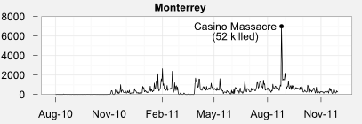
Tweet Stream Events
Tweets
Notes:
The number of daily tweets per day goes up and down constantly, spiking when violence erupts then decreasing when the city is calm. Staggered adoption. Practices are passed from city to city.

Slide 10
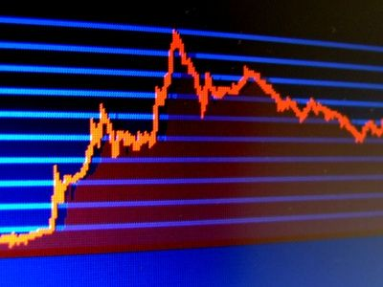
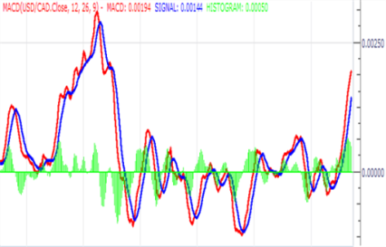

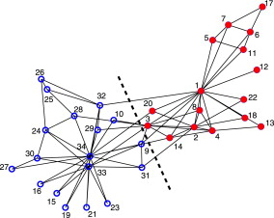
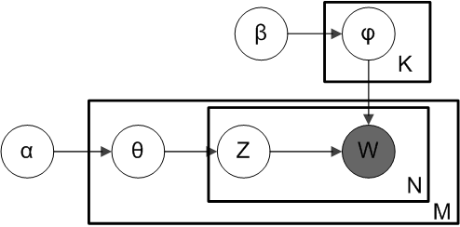

Event detection on Tweets
Traditional approaches: clustering+classification
  Issues: hard to do clustering on tweets/determine hot periods, etc
Our approach
S(w) = $\frac{Mean\left(Wt\right)−SD(Wt)}{SD(Wt)}$
Rank Features
Get Frequency of Features
Find Trending Features via trends analysis
Identified events
Clustering on Features

Slide 11

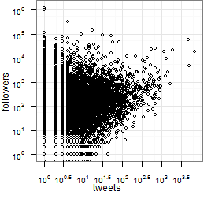


Curators
Average citizens
Notes:
Followers: Captured at the moment of the last tweet.
Curators: Act as operators. Mostly (selfrepoted) females.

Slide 12
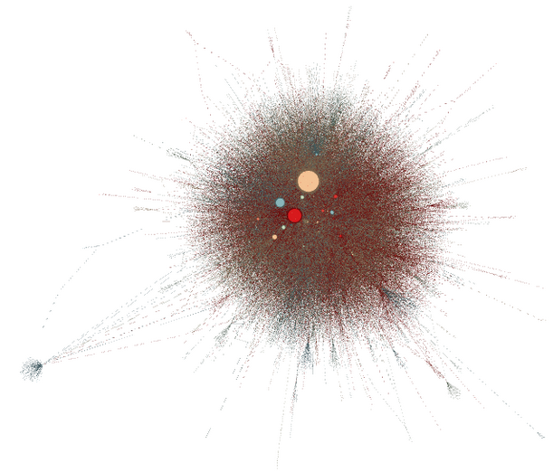
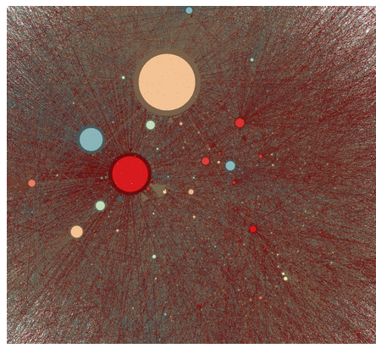
Retweet Network
curators
Size: in-degree (PageRank)
Notes:
Outsiders: celebrities.
Size: in-degree, denotes who id being RTed. Meaning: I trust the information that is given
Biggest node: a curator. Third most followed account in #ABCity, behind Calderon, TVNews.
Top 13 are anonymous, retweet each other too.

Slide 13
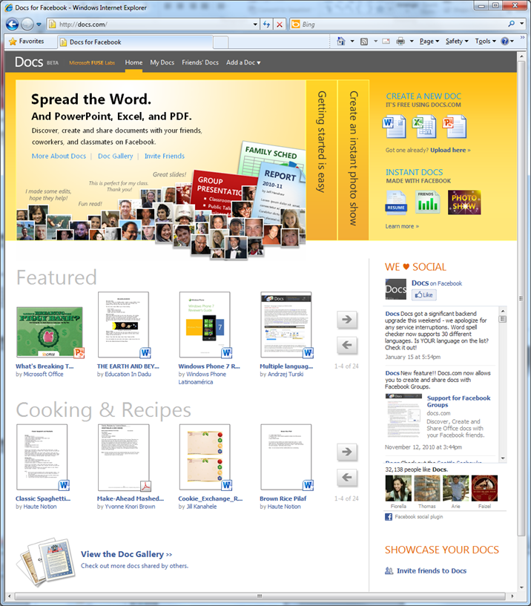
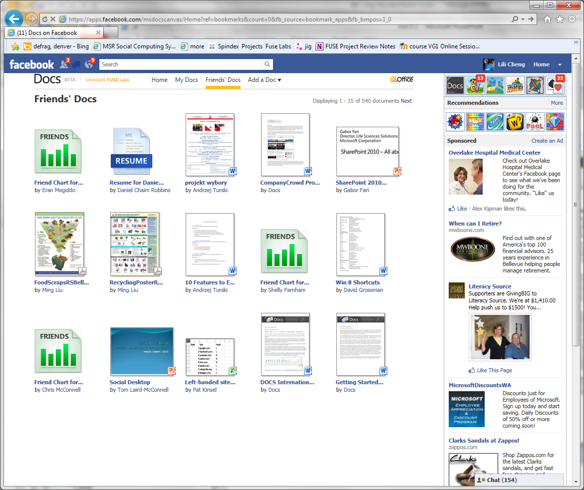
My Content/Files: Docs.com
Authoring and uploading: Office Docs: Word, PPT, Excel, PDF
Sharing to FB groups, friends, public

Slide 14
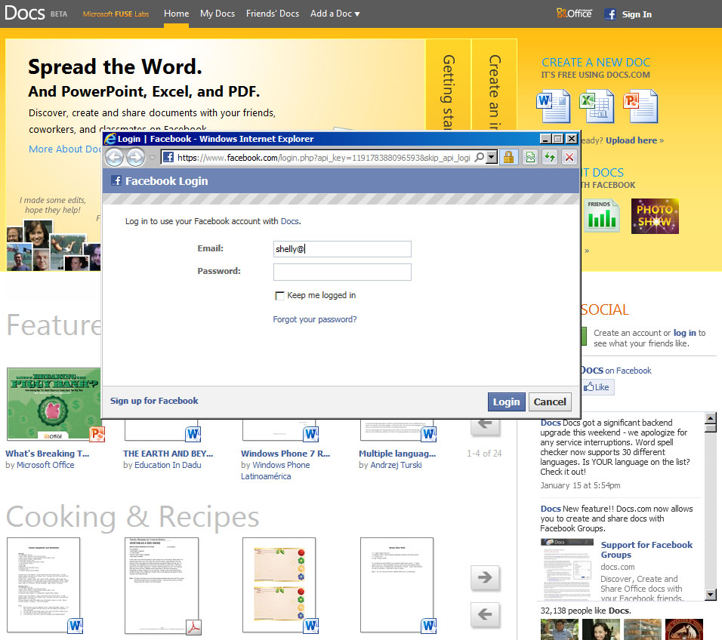
DOCS EXPERIENCE
Facebook connect sign in

Slide 15
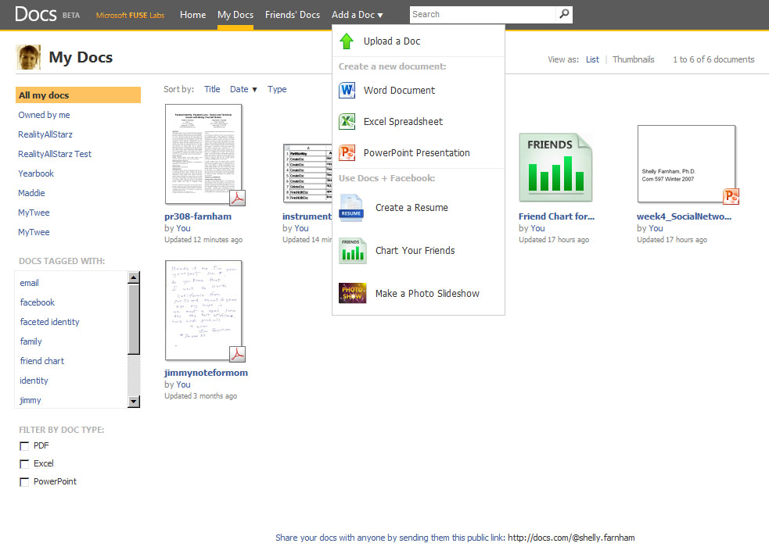
DOCS EXPERIENCE
Upload
Create

Slide 16
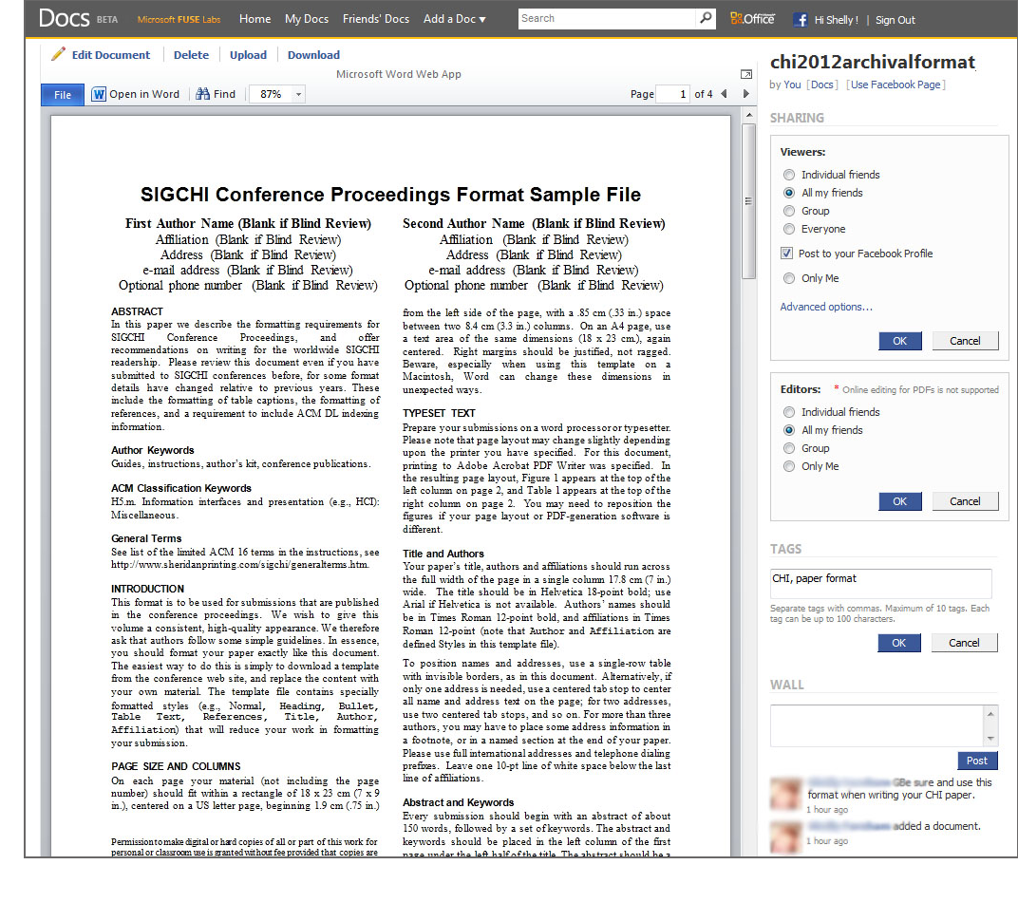
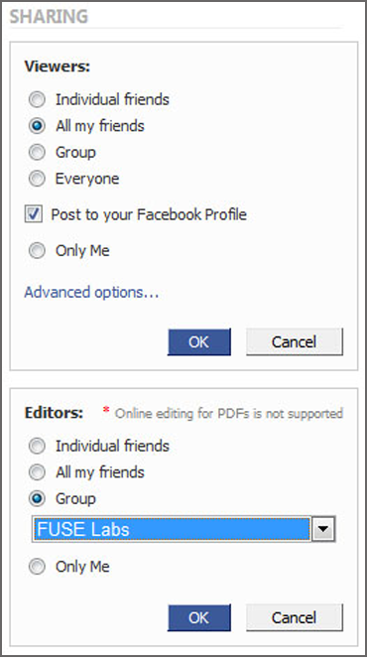
DOCS EXPERIENCE
Share
Network sharing options

Slide 17
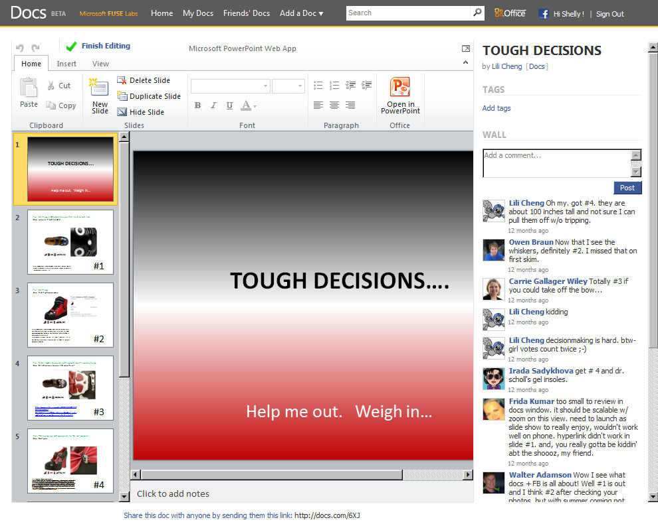
DOCS EXPERIENCE
Edit
Collaborate
Conversation

Slide 18
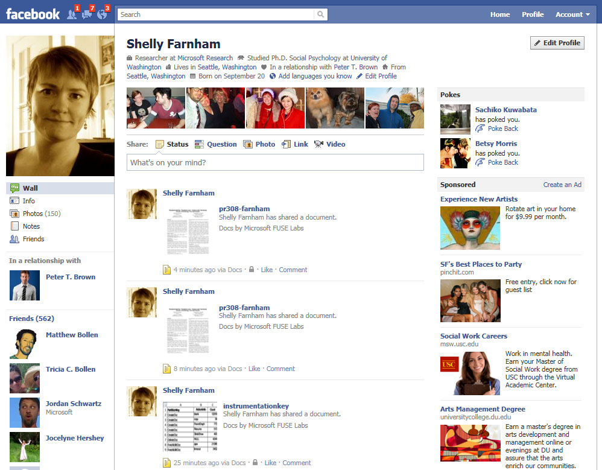
DOCS EXPERIENCE
Notifications in Facebook
Notifications in Email

Slide 19
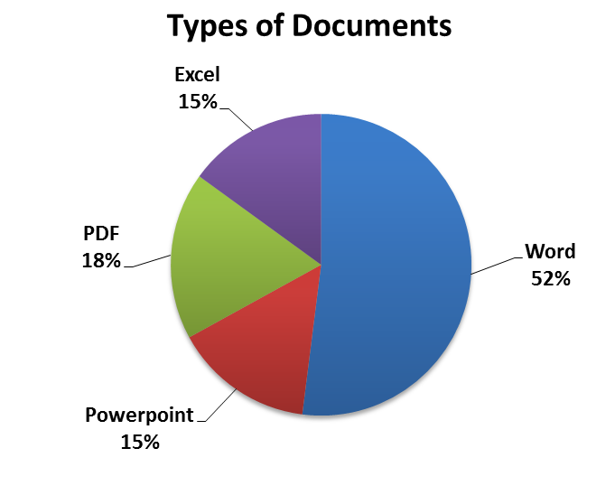
Usage: File Type and Content
Released April 2010
1,200,000+ users
500,000+ documents
Top 2000 docs, 35% PDFs

Slide 20

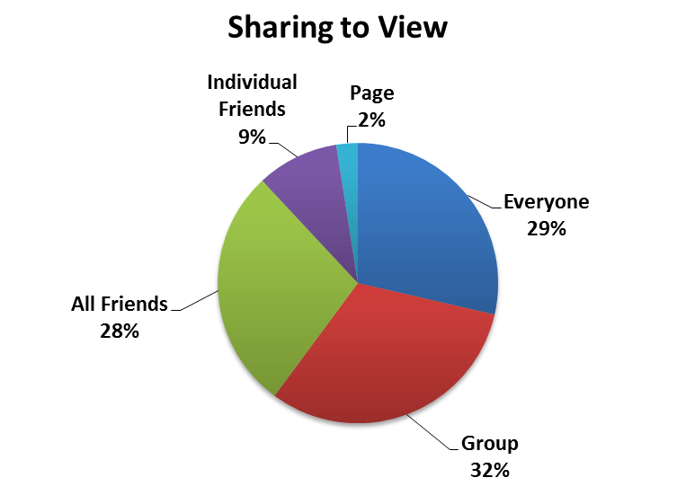
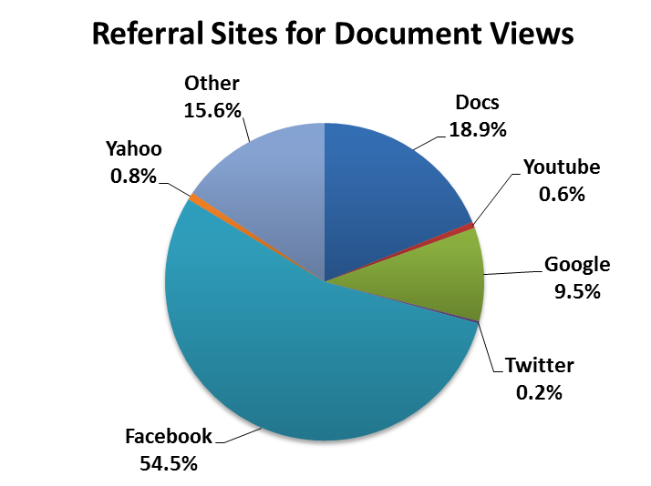
Usage: Sharing, Traffic, Reach
Sharing: FB Group integration
Traffic: Most refers from Facebook Feed
Reach: Public documents most viewed
Note:
56% private (personal store & online editing)
If sharing (44%), cast a broad net
  - 236 friends on average

Slide 21
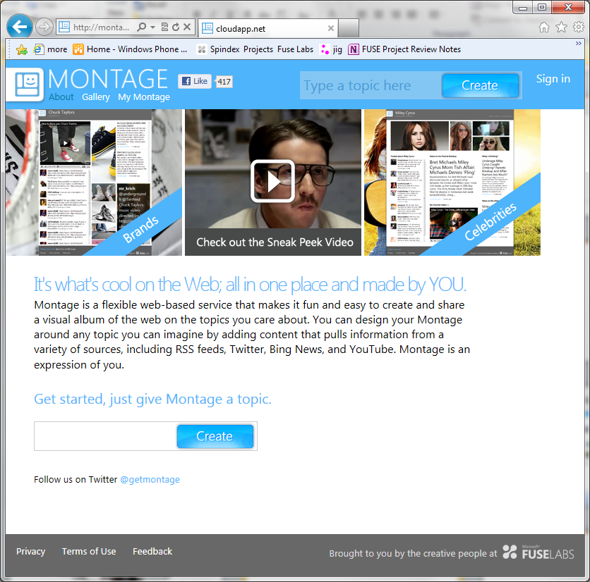
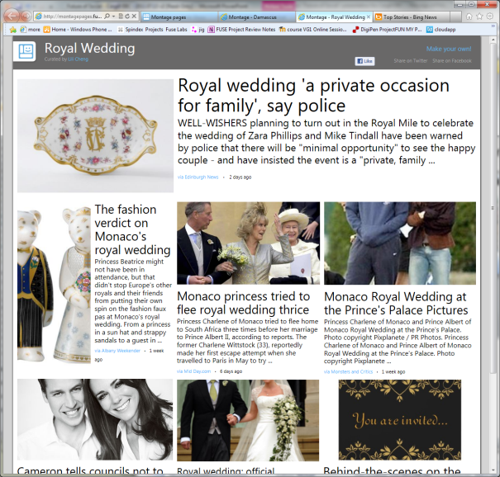
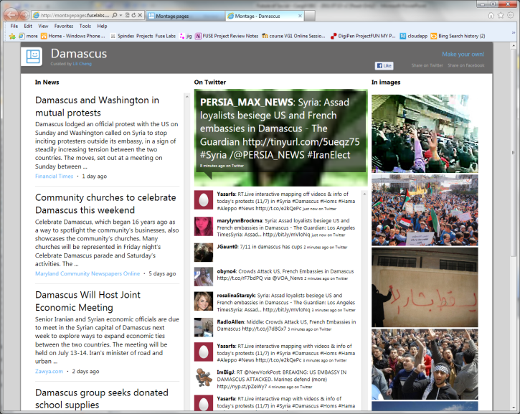
Authoring Social Data: Montage

Slide 22
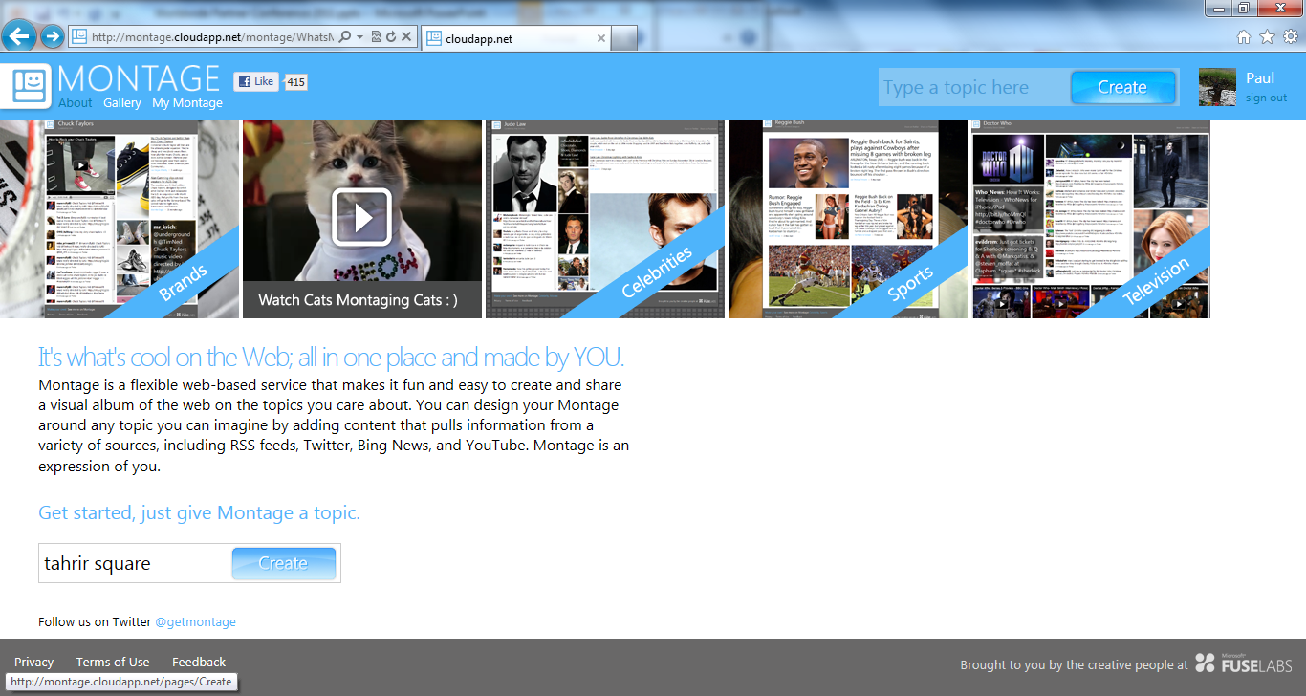

Slide 23
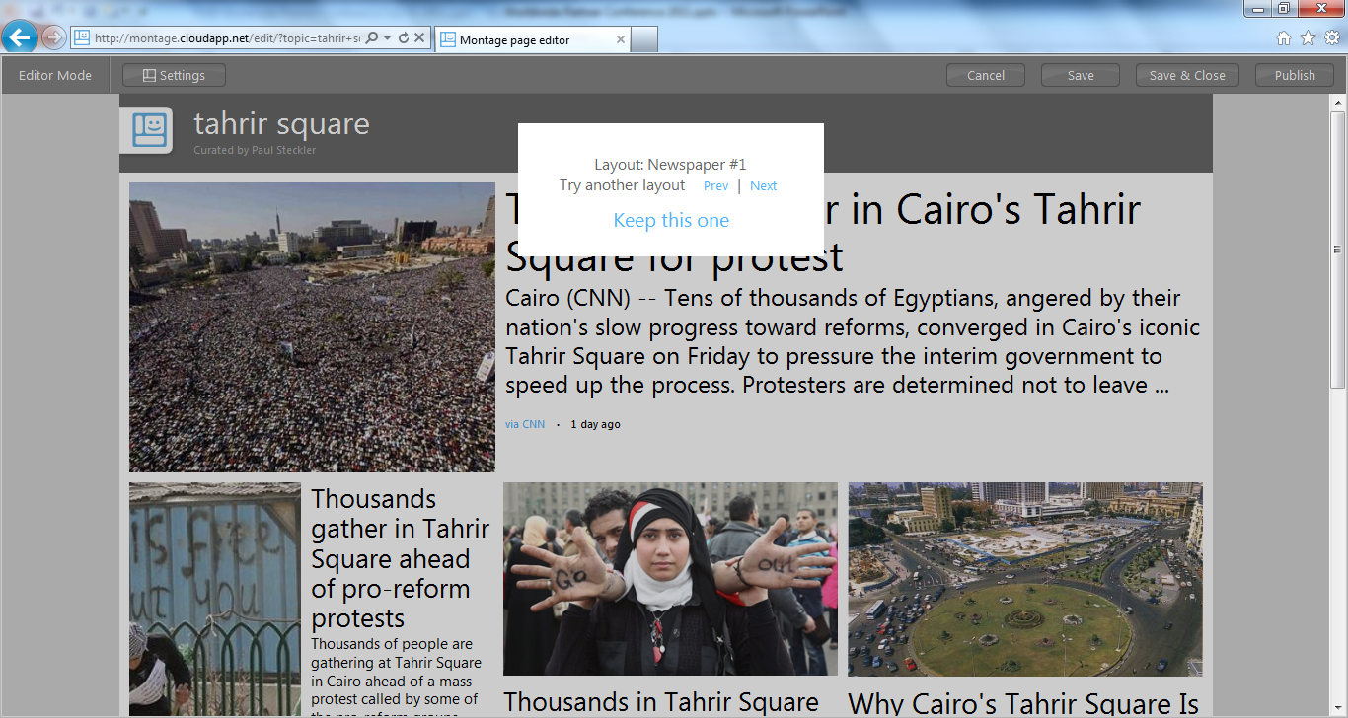

Slide 24
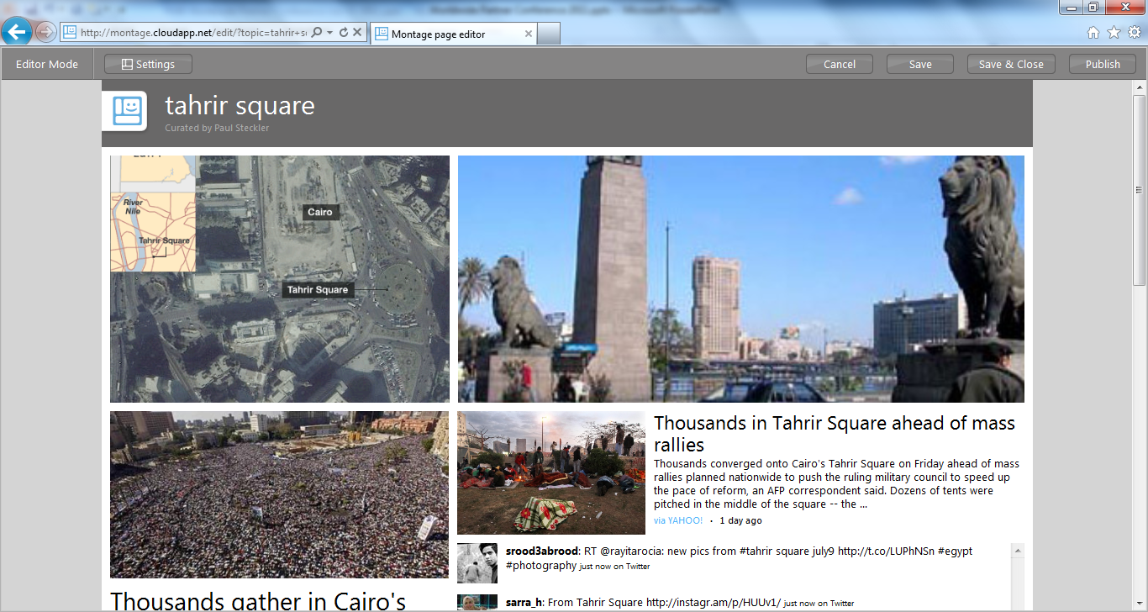

Slide 25
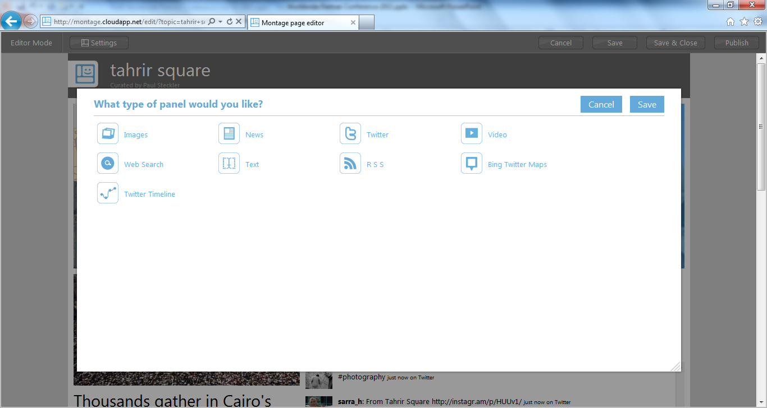

Slide 26
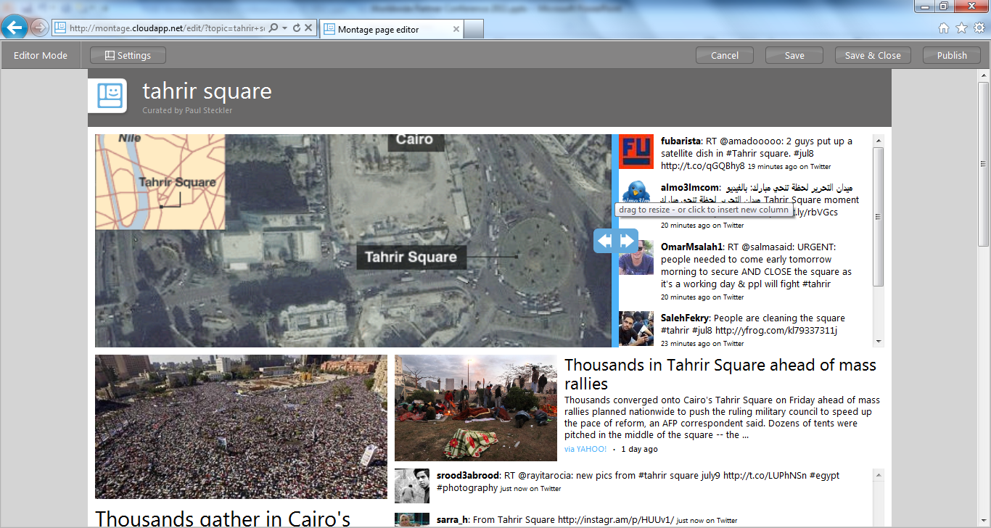

Slide 27
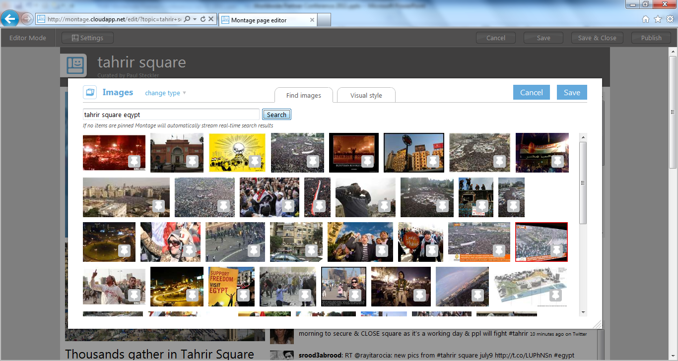

Slide 28
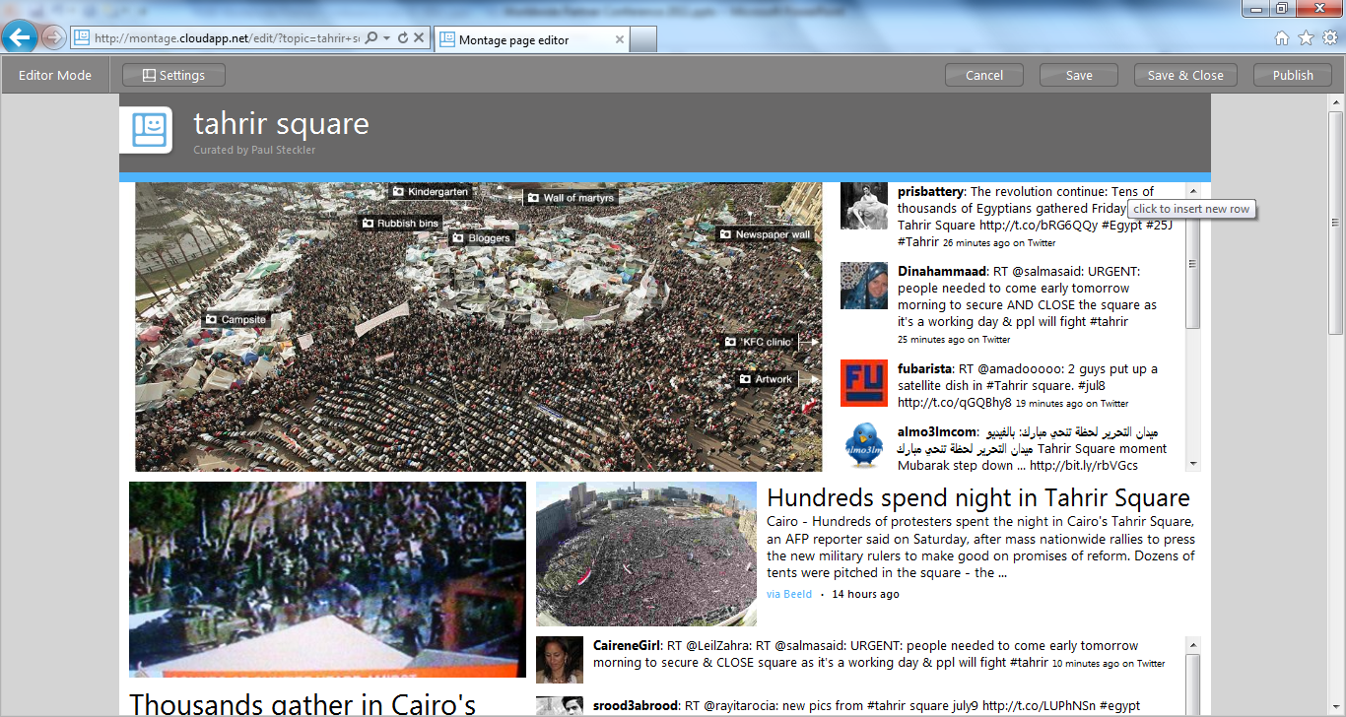

Slide 29
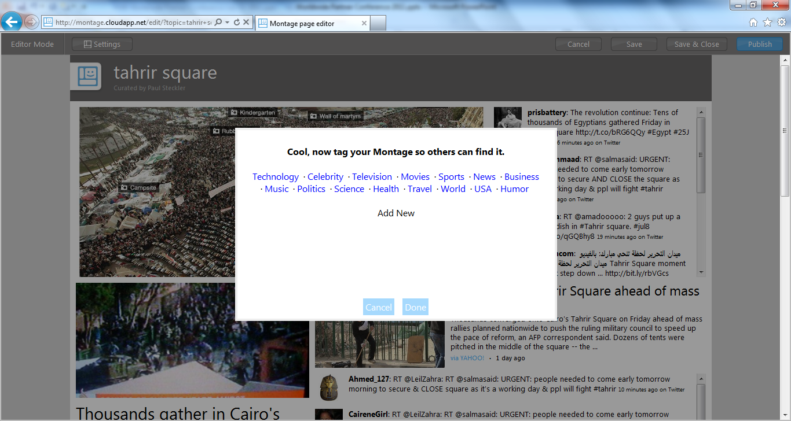

Slide 30
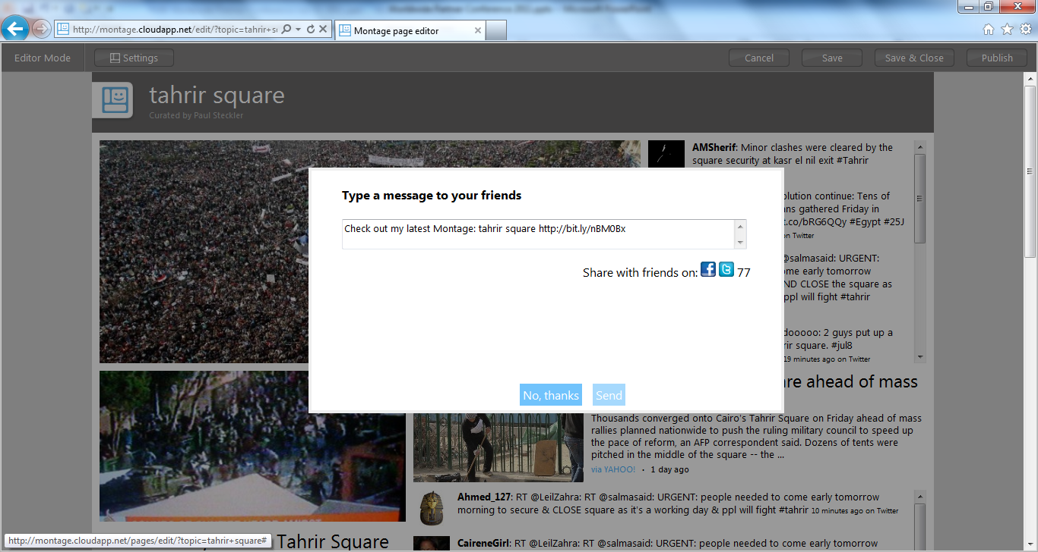

Slide 31
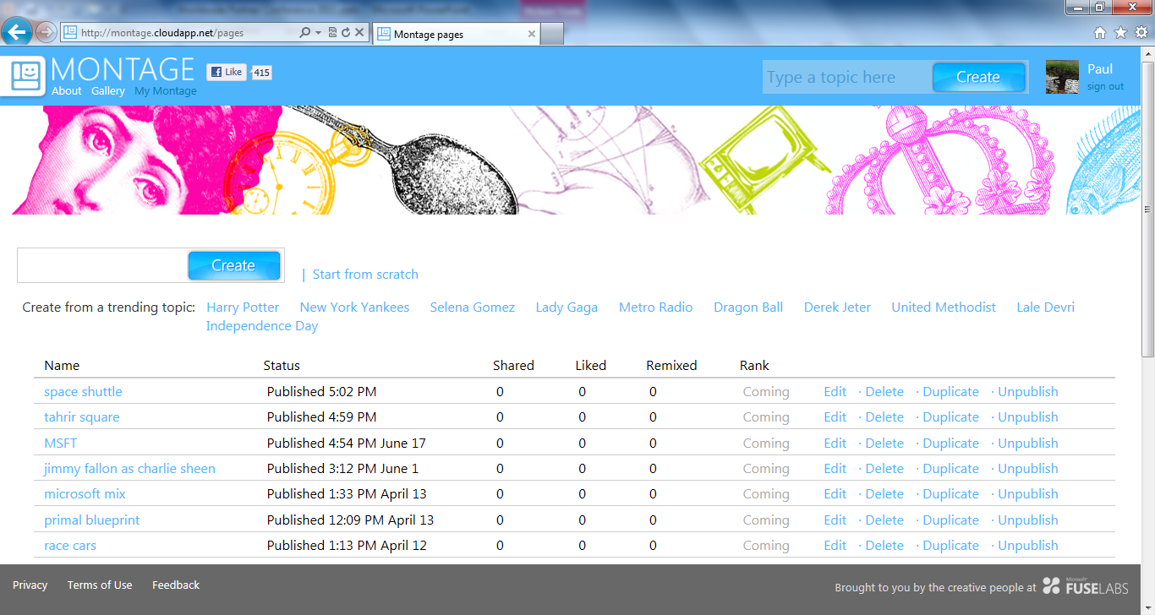

Slide 32
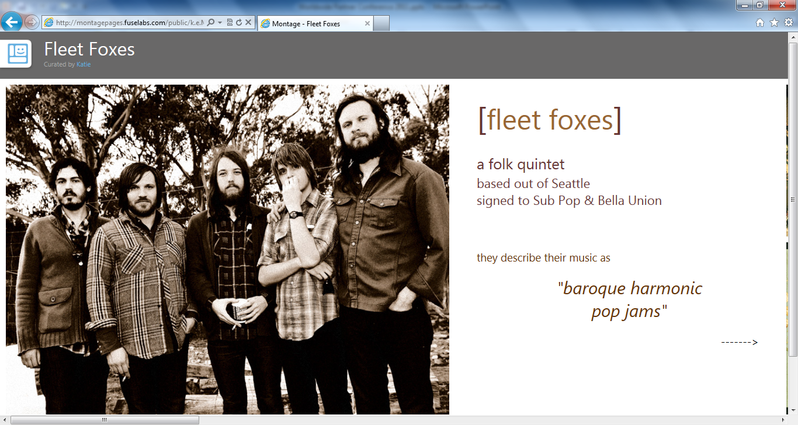

Slide 33
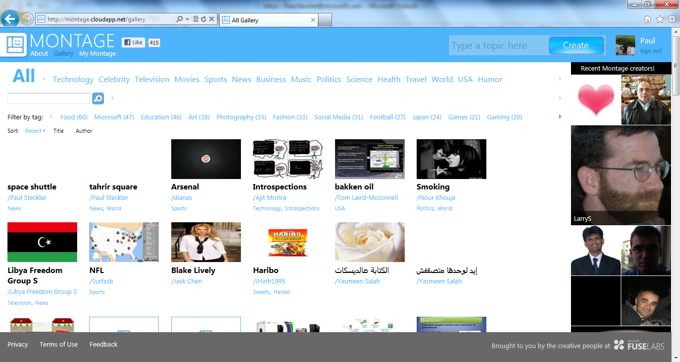

Slide 34
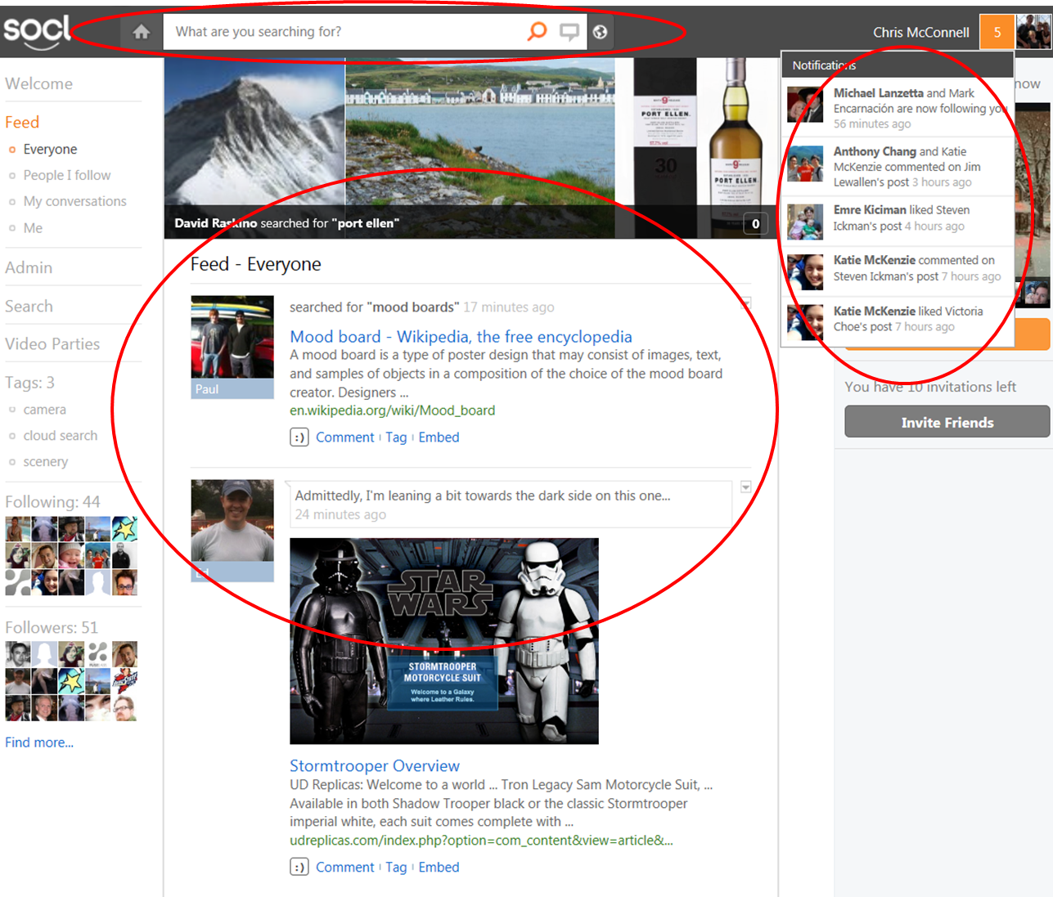
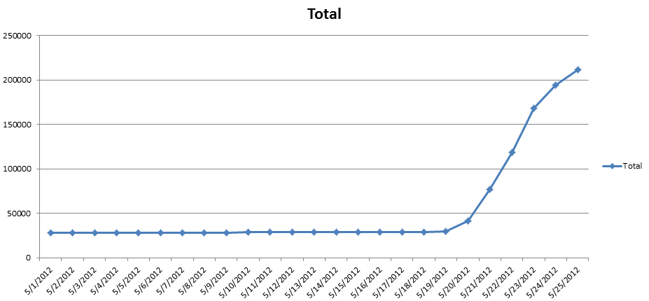
So.cl
Use search to express & share your ideas through
beautiful story collages
So.cl
  Integrates Search & Social
  Data reuse
    Bing API’s
    So.cl Public data & API’s
Usage
  300,000+ users

Slide 35
Types of Users
Factor Analysis for Associated Behaviors:
Three types of usage – creating, socializing, browsing
Component Matrixª
 | Component
Type: | Creators | Socialites | Browsers
% Variance: | 32% | 12% | 9%
Created post | .86 | .17 | .10
Invited | .01 | -.16 | .63
Followed | -.03 | .10 | .37
Added item to post | .83 | .08 | -.06
Searched | .81 | .03 | .17
Commented | .36 | .64 | .09
Liked post | .15 | .58 | .32
Liked comment | .13 | .80 | .06
Messaged | -.09 | .50 | -.08
Viewed person | .22 | .47 | .48
Navigated to All | .51 | .37 | .53
Joined party | .17 | .09 | .68
Factors about equally predict if user comes back
Regression Coefficents
 | Beta | t | Sig
Creating | .14 | 5.28 | .000
Socializing | .07 | 2.61 | .000
Browsing | .19 | 7.20 | .000
Browsing stronger predictor of overall activity level
Regression Coefficients
 | Beta | t | Sig
Creating | 0.20 | 7.89 | 0.00
Socializing | 0.17 | 6.58 | 0.00
Browsing | 0.29 | 9.07 | 0.00

Slide 36
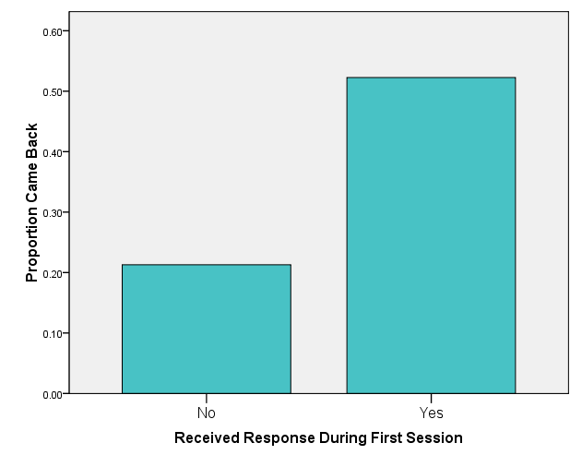
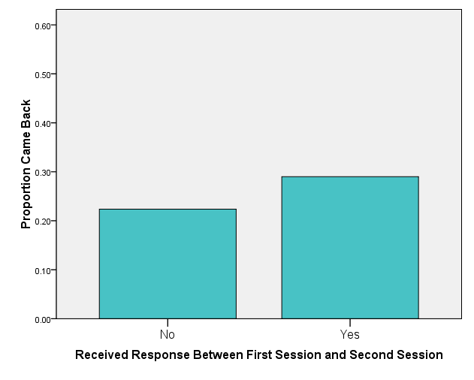
Predictors of Coming Back
Social responses inspire people to return to site, especially if occurring during first session
N = 1268
N = 111
N = 1083
N = 293
Social responses to user: following, commenting, liking post, liking comment, riffing

Slide 37
SO.CL Research Dataset Project
Weekly So.cl Research Dataset Dumps
  To be available at: Http://connect.microsoft.com
  User table, User events table, Posts table
Restricted access for researchers to download
Release date: October 2012
RowId | CalendarID | CreatedOnUtC | SourceUserId | TargetUserId | ActionId | ActionDescription | Context
103277707 | 2012070220 | 02:52.8 | 41727 | 41727 | 145 | Created a public post | http://digital-photography-school.com/6-portrait-lighting-patterns-every-photographer-should-know
103277712 | 2012070220 | 03:02.1 | 212142 | 229620 | 49 | Create a comment on a post | riffed on Lucas's post with <link>@Fagno-Cardoso-Ramos?v=feed&f=riffs&i=tBe.ktFIUal9Qn3P&r=xjY.bzX4AhAo "apple"</link>
103277751 | 2012070218 | 41:42.0 | 46 | 181383 | 49 | Create a comment on a post | looks yummy!
103277867 | 2012070218 | 55:17.8 | 288233 | 288233 | 145 | Created a public post | http://www.escobarnews.com/Noticias/20120702-programa-municipal-el-cine-y-nuestra-hitoria.html
103277870 | 2012070218 | 55:28.7 | 269445 | -1 | 73 | User joins party | 4956
103278173 | 2012070219 | 11:40.0 | 112329 | 120018 | 49 | Create a comment on a post | yummy
103278198 | 2012070219 | 13:34.4 | 112329 | 306540 | 49 | Create a comment on a post | Good friends
103278267 | 2012070219 | 19:13.2 | 141595 | 141595 | 145 | Created a public post | http://9gag.com/gag/4651159
103278288 | 2012070219 | 21:42.8 | 9224 | 9224 | 49 | Create a comment on a post | I don't know.
103278648 | 2012070220 | 05:44.7 | 142010 | -1 | 73 | User joins party | 10542
103278651 | 2012070220 | 05:47.1 | 314003 | 314003 | 145 | Created a public post
103278683 | 2012070220 | 10:04.3 | 142010 | 278297 | 49 | Create a comment on a post | yeah...its like a little devil genie came out of bottle...:D
103278766 | 2012070218 | 14:14.1 | 4127 | 4127 | 145 | Created a public post
103278955 | 2012070218 | 35:35.0 | 606 | 285223 | 49 | Create a comment on a post | hello <link>@Marcelo-Bastos Marcelo Bastos</link>
103279070 | 2012070218 | 49:09.8 | 197253 | 197253 | 49 | Create a comment on a post | Coz it was midnight.........
103279282 | 2012070219 | 20:22.2 | 57 | 57 | 149 | Created a Riffed public post | big spider eats bird
103279284 | 2012070219 | 20:23.4 | 57 | 278297 | 49 | Create a comment on a post | riffed on Godoy's post with <link>@Richard-Zaragoza-2?v=feed&f=riffs&i=0v.ktFI2tIdioG7&r=1AOf.ktFHyUJWzipi "yikes. and its real"</link>
103279426 | 2012070219 | 37:10.9 | 278297 | 278297 | 145 | Created a public post | pooped in your shoes
103279449 | 2012070219 | 42:04.6 | 304160 | -1 | 83 | remove a video from the party queue | arg0=10313, queueEntryId=58719
103279585 | 2012070219 | 59:21.7 | 44092 | 44092 | 145 | Created a public post
103279636 | 2012070220 | 08:00.9 | 22789 | 22789 | 145 | Created a public post
103279746 | 2012070218 | 42:29.0 | 294345 | 285223 | 49 | Create a comment on a post | buenas tardes!

Slide 38


Student and Research Outreach
Goals:
  Promote research at intersection of information and social media
  Increase scope of research we can perform
  Foster ecosystem of So.cl community
Social Media Day at Faculty Summit 2012
Student Social Media Advisor’s Program
http://fuse.microsoft.com/ssmap
iConference Social Media Expo
http://www.ischools.org/iConference13/2013index/
Sharing So.cl Research Dataset Project
Social Media Day, Faculty Summit

Slide 39
Social Data
Big Social Networks (Facebook, Twitter, LinkedIn)
  Scale
  Legal Restrictions
Build your own
  Creating community is difficult
  Requires cutting-edge technology
So.cl
  API and Data released soon

Slide 40
Questions?
  chrimc@microsoft.com
  @chrimc
  http://fuse.microsoft.com

