Slide 1

What do to about data?
A Research Funder’s Perspective
Myron Gutmann
Assistant Director
National Science Foundation
Directorate for Social, Behavioral and Economic Research

Slide 2
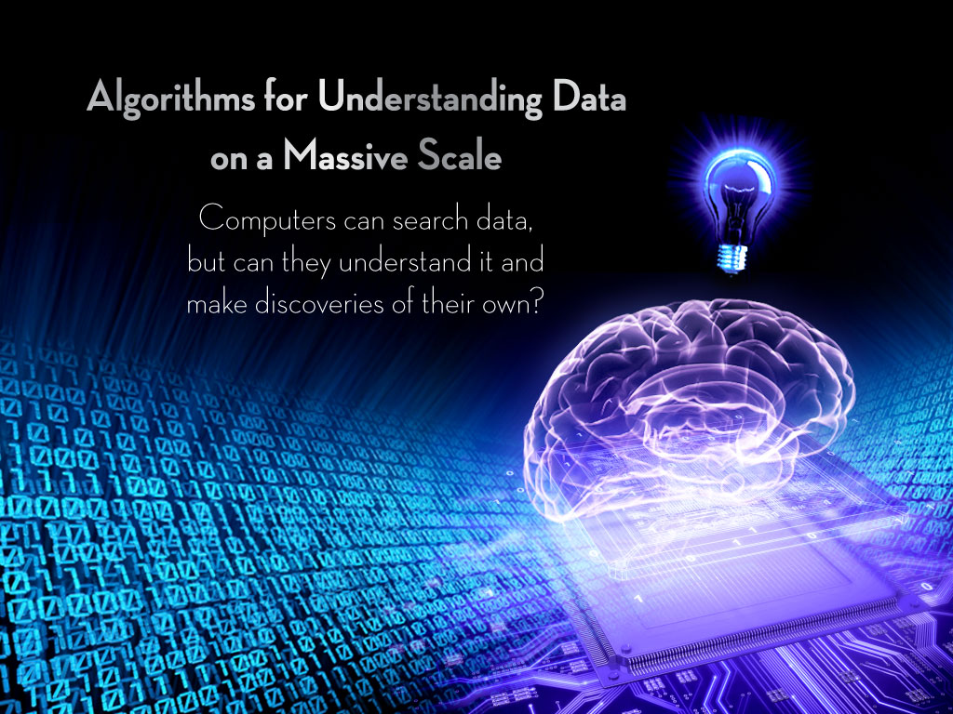
Advances in information technologies are transforming the fabric of our society and data represents a transformative new currency for science, engineering, education and commerce.
Image Credit: CCC and SIGACT CATCS
Notes:
Advances in information technologies are transforming the fabric of our society and data represents a transformative new currency for science, engineering, education and commerce.

Slide 3
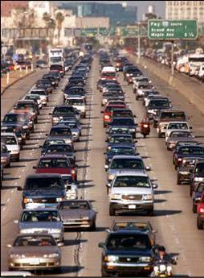
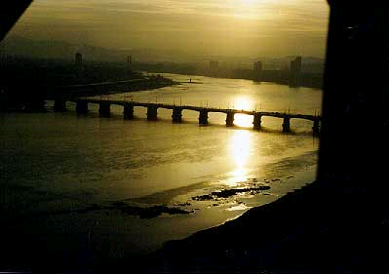
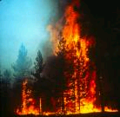
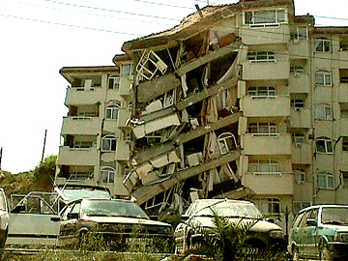
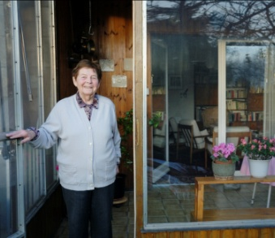
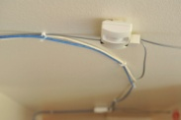
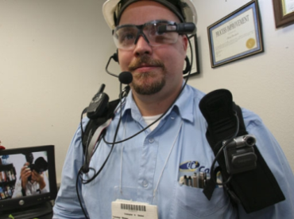



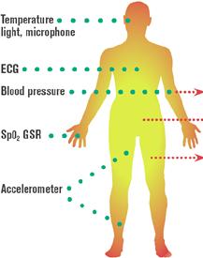


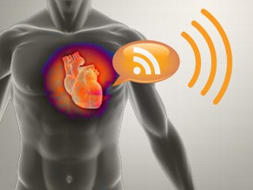
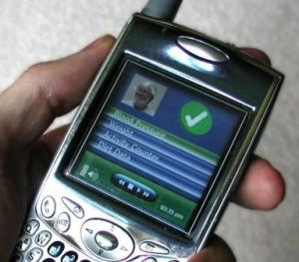
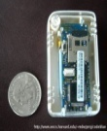
Smart Sensing, Reasoning and Decision
Environment Sensing
Emergency Response
Situation Awareness: Humans as sensors feed multi-modal data streams
Percepts (sensors)
Agent (Reasoning)
Credit: Photo by US Geological Survey
Pervasive Computing
Social Informatics
Actions (controllers)
People-Centric Sensing
Smart Health Care
Sense
Assess
Intervene
Evaluate
Identify
Public Sensing
Social Sensing
Personal Sensing
Source: Sajal Das, Keith Marzullo
Notes:
3
This explosive growth in the size, complexity, and rate of digital data is generated/produced/created by:
modern experimental methods and observational (longitudinal) studies,
large-scale simulations,
scientific instruments such as telescopes and particle accelerators,
Internet transactions,
email, videos, images, click streams…
Not to mention … ubiquitous widespread deployment of sensors all around us:
in the environment,
in our critical infrastructure such as bridges and smart grids,
in our homes, and even on our clothing!

Slide 4
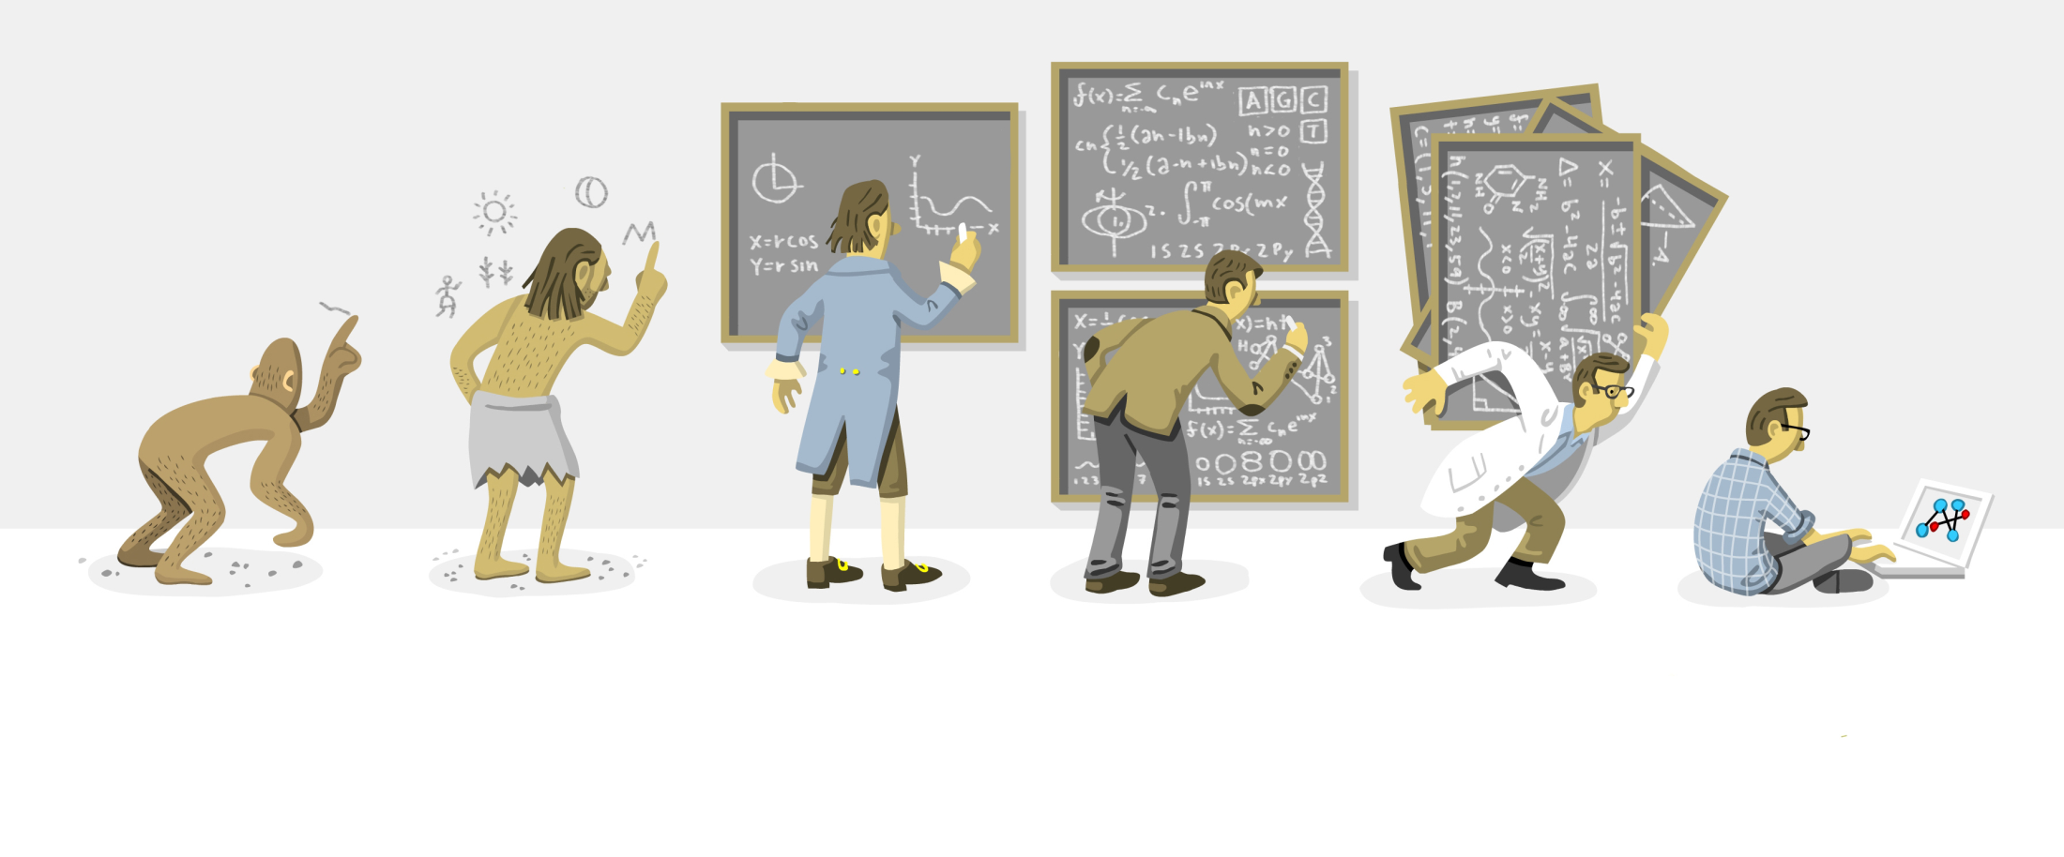
Why is Data Important?
Transformative implications for commerce and economy
Potential for addressing some of the society’s most pressing challenges
Critical to accelerating the pace of discovery in almost every science and engineering discipline
Image Credit: Chi Birmingham
Notes:
Why is Big Data Important?
First, insights and more accurate predictions from large and complex collections of data have important implications for the economy.
Access to information is transforming traditional businesses and is creating opportunities in new markets.
Big Data is driving the creation of new IT products and services based on business intelligence and data analytics, and … is boosting the productivity of firms that use it to make better decisions and identify new business trends.
Second, Big Data also has the potential to solve some of the Nation’s most pressing challenges -- in science, education, environment and sustainability, [government,] medicine (OR healthcare), commerce, and cyber and national security -- with enormous societal benefit and laying the foundations for U.S. competitiveness for many decades to come.
Third, advances in Big Data are critical to accelerate the pace of discovery in almost every science and engineering discipline. From new insights about protein structure, biomedical research and clinical decision-making, and climate modeling, to new ways to mitigate and respond to natural disasters, and develop new strategies for effective learning and education – there are enormous opportunities for data-driven discovery!
Data access and analysis is already having enormous impact. You can imagine a day when:
Complete health/disease/genome/environmental knowledge bases enable biomedical discovery, and patient-centered therapy.
The data can be mined to spot unwanted drug interactions, or predict onset of diseases.
By linking together finance, human resources, supply chain, customer management systems, companies can use data mining techniques to get a complete picture of their operations – identify new business trends, operate more efficiently, and improve forecasting.
Accurate high-resolution models support forecasting and management of increasingly stressed watersheds and ecosystems; Consumers have the information they need to make optimal energy consumption decisions in their homes and cars;
Accurate predictions of natural disasters, such as earthquakes, hurricanes, and tornadoes, enable life-saving and cost-saving preventative actions;
Our cyber-enabled world is safe, secure, and private, enabling assured use of our critical infrastructure and on-line commerce; and
… why it’s transformative for education and WFD:
Students and researchers have access to intuitive tools to view, understand, and learn from publicly-available, large scientific data sets on everything from genome sequences to astronomical star surveys, from public health databases to particle accelerator simulations, and our teachers and educators use student performance analytics to improve learning and enhance assessment.
(From FROM TECH AMRERICA SPEECH)

Slide 5

The Age of Data: From Data to Knowledge to Action
Data-driven discovery is revolutionizing scientific exploration and engineering innovations
Automatic extraction of new knowledge about the physical, biological and cyber world continues to accelerate
Multi-cores, concurrent and parallel algorithms, virtualization and advanced server architectures will enable data mining and machine learning, and discovery and visualization of Big Data
Notes:
1) Today, science gathers data at an ever-increasing rate across all scales and complexities of natural phenomena. We need to store, integrate, and extract meaning and information from all of these raw numbers and data points.
The explosive growth of scientific and social data:
2) Creates enormous opportunities in harnessing large-scale data, turning it into information and extracting knowledge from it.
In other words, storage and accessing data is just the beginning. We need to go from Data → Predictive Models → Decision Analysis
3) Enabled by data mining and machine learning, discovery and visualization techniques, the shift toward indirect, automatic extraction of new knowledge about the physical and biological world, and social and behavioral trends continues to accelerate.
4) What’s possible: New insights into science, spot business trends, prevent diseases, manage our previous resources such water better, …
This is all enabled by cheap storage, huge data centers, easier access and programmability, and advances in hardware architectures and data management tools.
------------
1) We are in a period where it’s been called the “Era of Data and Information.”
Actually, the truth is that we’re drowning in the DATA TSUNAMI
2) We have seen an Explosive Growth in Size, Complexity and Data Rates generated by generated by modern experimental and observational methods.

Slide 6
Future SBE research:
Technology and data drivers
Scale: More data from more sources (environmental, sensor, administrative, survey, commercial, usage, and so on)
Density (merge, overlap, georectify)
Tools (statistics, GIS, network analysis, modeling, scenarios)
Granularity (fMRI, administrative, commercial and behavioral level)
Greater access to and demand for high performance computational resources
Notes:
SBE has a long tradition of using computational and cyber technology in SBE research
Shared traditions grew out of large-scale surveys and traditions of archiving, sharing, and reuse
Newest research infrastructure is solidly “cyber” and largely sustainable
Next-generation research questions at new scales while preserving confidentiality and privacy
Vision of SBE-2020:
Future research will be collaborative, multidisciplinary, and data intensive and will address societal problems and fundamental scientific questions

Slide 7
Examples of Research Challenges
More data is being collected than we can store
  Analyze the data as it becomes available
  Decide what to archive and what to discard
Many data sets are too large to download
  Analyze the data wherever it resides
Many data sets are too poorly organized to be usable
  Better organize and retrieve data
Many data sets are heterogeneous in type, structure, semantics, organization, granularity, accessibility …
  Integrate and customize access to federate data
Utility of data limited by our ability to interpret and use it
  Extract and visualize actionable knowledge
  Evaluate results
Large and linked datasets may be exploited to identify individuals
  Design management and analysis with built-in privacy preserving characteristics

Slide 8

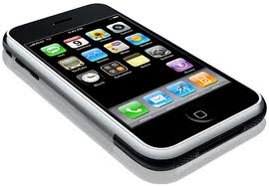





Many sources of data. . .
Today
1988
Remarkable
Pace of Innovation
MOBILE
SOCIAL NETWORKS
BLOGS
EMAIL
VOIP
VIDEO
What can NSF do?
Notes:
Universal connectivity and the explosive growth in volume and diversity of Internet traffic is creating enormous amounts and types of data.
Consider your telephone in 1988 … compared with the spectrum of communication modes TODAY.

Slide 9
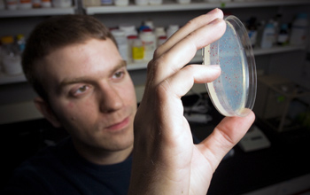
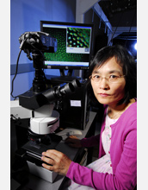
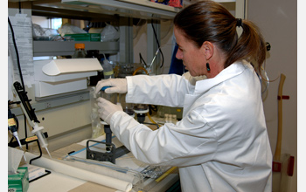
Establish research priorities
Credit (left to right): G. L. Kohuth, Michigan State University; Georgia Tech; photo by Gary Meek; Peter Rejcek

Slide 10
Secure Cyberspace
Health & Wellbeing
Transportation & Energy
Education and Workforce Development
Environment & Sustainability
Manufacturing, Robotics, & Smart Systems
Emergency Response & Disaster Resiliency
Notes:
Big Data addresses many of our national priorities – from healthcare to …
Let me just elaborate some more on a couple of these.

Slide 11

Organize challenges in key areas

Slide 12


Provide programmatic support

Slide 13
Big Data Launch
Federal Big Data R&D Initiative launched by White House OSTP on March 29, 2012 at AAAS
Federal Announcements:
  NSF
  NIH
  USGS
  DoD
  DARPA
  DOE
Image Credit: National Science Foundation
More information available at: http://nsf.gov/news/news_summ.jsp?org=CISE&cntn_id=123607&preview=false
Notes:
The efforts of that group were announced during the Administration’s Big Data R&D Initiative Launch on Mar 29.
The event included federal announcements by…
And a panel discussion, moderated by Steve Lohr of NYTimes, with thought leaders in big data from industry and academia

Slide 14
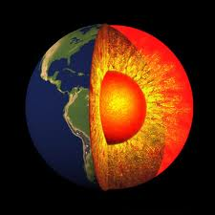

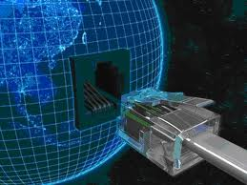





Earthcube
EAGER awards announced as part of White House Big Data
Integrates geosciences data and high-performance computing technologies in an open, adaptable and sustainable framework to enable transformative research and education in Earth System Science
Innovative Model: Community designed, community owned, community governed
Interdisciplinary research:
  Building and sustaining “new” communities
  Workshops to bring together (GEO, SBE, CISE) communities
  EAGER awards to seed new research
Notes:
The first round of awards for Earthcube, were announced, laying the first step in the foundation to integrate data into a framework that will expedite the delivery of geoscience knowledge.

Slide 15
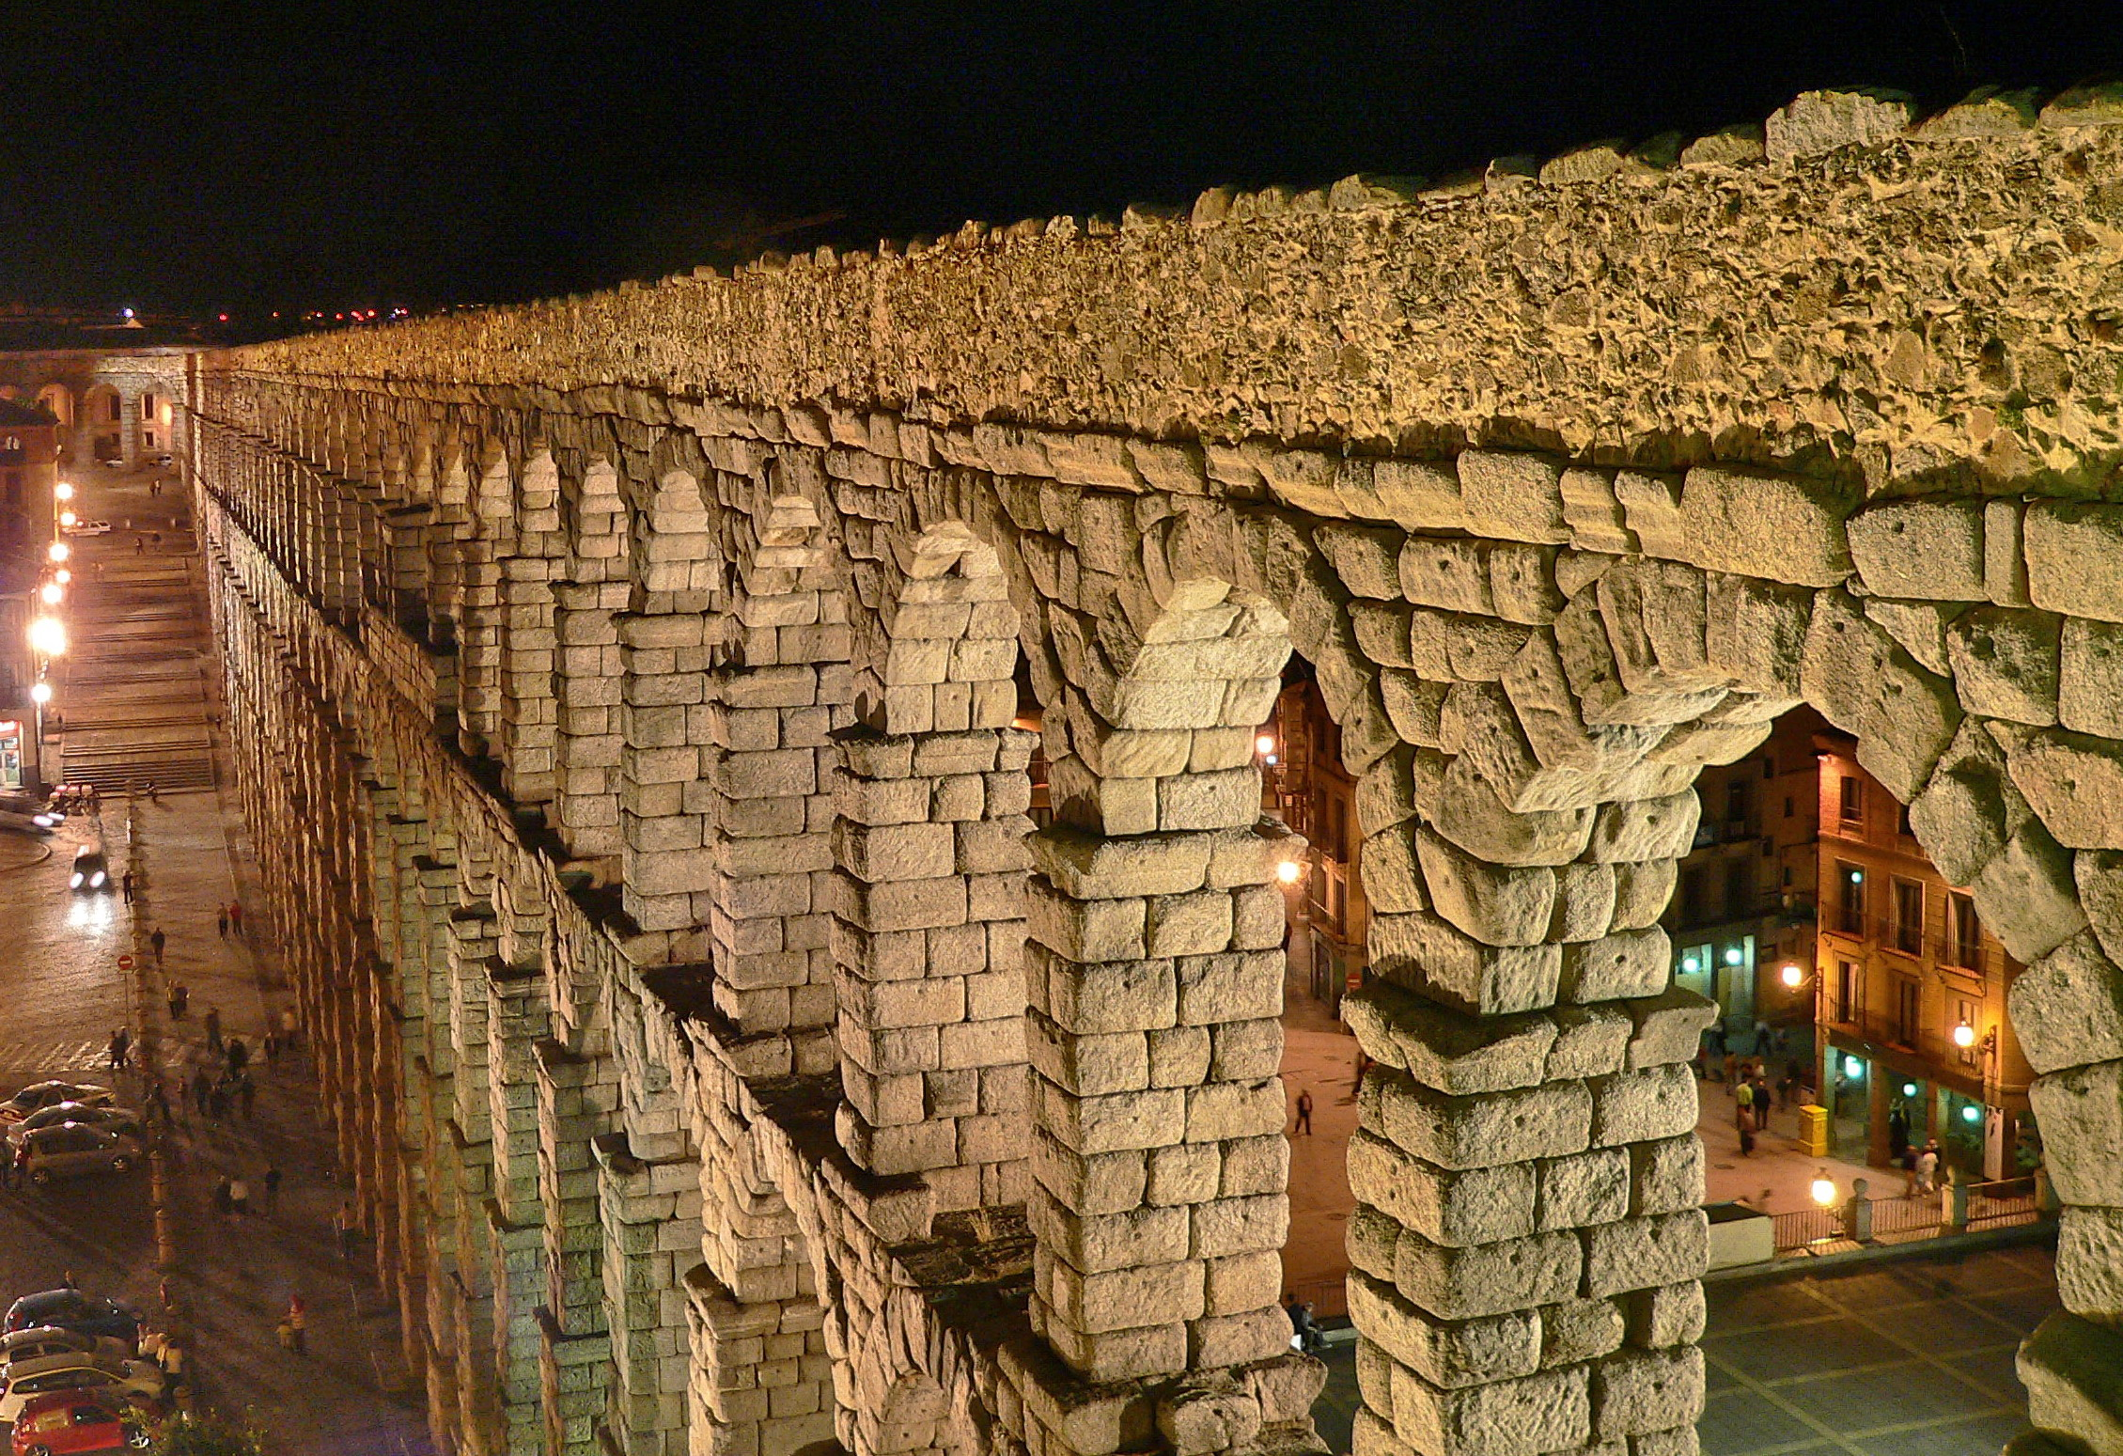
Advance the research infrastructure
Credit. Night view of the Aqueduct of Segovia, 8 October 2006, Manuel González Olaechea. This file is licensed under the Creative Commons Attribution 3.0 Unported license.

Slide 16





SABINS
School Attendance
Boundary Information System
GSS General Social Survey
PSID
A national study of socioeconomics and health over lifetimes and across generations
19

Slide 17
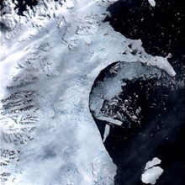
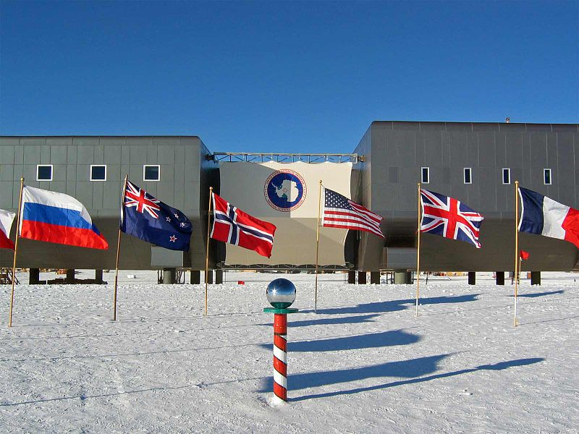

Polar research facilities
Credit: Break up of Larsen B ice shelf, MODIS images from NASA's Terra satellite supplied by Dr. Ted Scambos; National Snow and Ice Data Center, University of Colorado, Boulder; U.S. Antarctic Program, National Science Foundation; Credit: Opher Ganel, University of Maryland;National Science Foundation

Slide 18

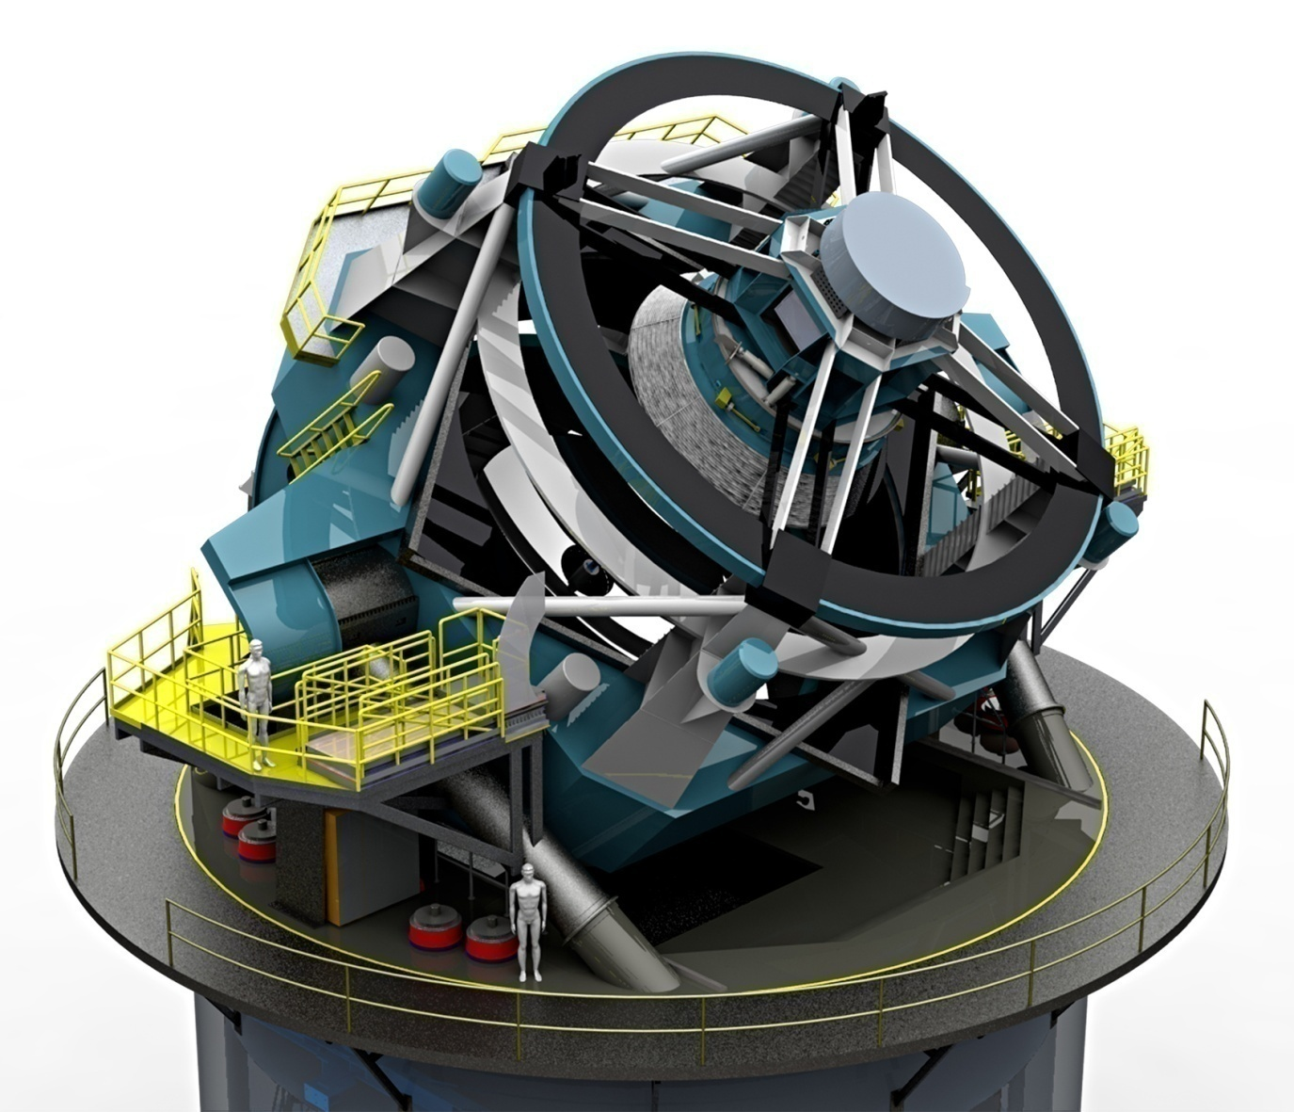
LSST Vital Statistics
(Large Synoptic Survey Telescope)
3.3 gigapixel digital camera
40 terabytes of data nightly
Send the data to the U.S. Daily – from Chile
50,000 to 100,000 “alerts” per night
Complete coverage of the
visible sky twice per week
Ten year prime mission
Multiple transients every
second of every night

Slide 19

Implement procedures

Slide 20
Data Management Plan
Describe how the PI will conform to data policy associated with the competition to which the proposal is submitted. If none exists, to NSF’s generic policy.
Not extend the 15-page project description
Will be evaluated during merit review as Intellectual Merit or Broader Impacts or both, as appropriate.
May simply say “No plan is needed”, but this needs a justification. Statement will be subject to peer and Program Officer review/consideration.

Slide 21
Data Publication Counts
Policy Guide for October, 2012 (effective January 2013)
Investigators will now report “Products” instead of “Publications.”
A list of: (i) up to five products most closely related to the proposed project; and (ii) up to five other significant products, whether or not related to the proposed project.
Acceptable products must be citable and accessible including but not limited to publications, data sets, software, patents, and copyrights.
Notes:
NSF policy updates appear annually in October. This was announced in the Federal Register together with a request for comment
We’re already thinking about the 2013 announcement
And we intend to follow this with more, because the field of information dissemination from research is evolving rapidly and
Becoming more involved (as the change from publications to products shows)

Slide 22
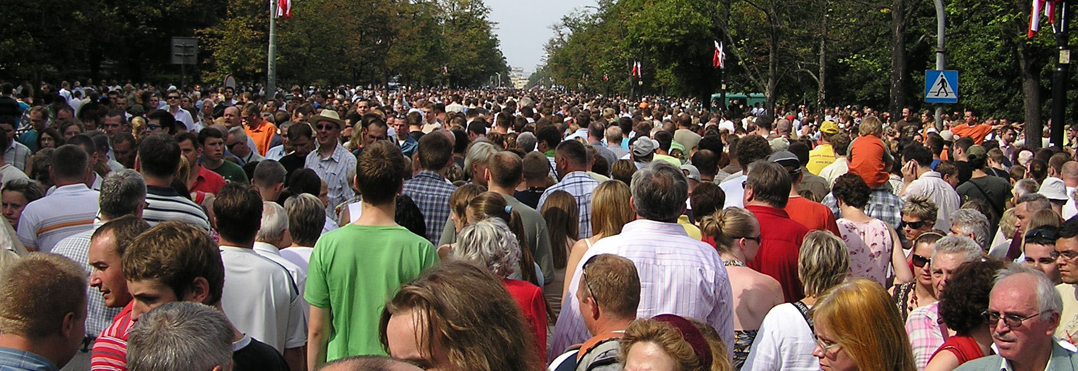
Thank you!
mgutmann@nsf.gov
Notes:
I’ve been talking about data and infrastructure, but data-related activities represent only part of the SBE budget.
The remainder goes to extramural research administered through the Social and Economic Sciences Division, the Behavioral and Cognitive Sciences Division, and the SBE Office of Multidisciplinary Activities.
The research divisions and SMA support programs that advance SBE’s mission to study human characteristics and human behaviors across temporal and spatial dimensions and multiple levels of analysis -- from studying the human brain to implications of decision making in a fragmented yet dynamic and interconnected world.
This is very diverse research – SBE researchers appear in something on the order of 25 different academic departments.
And we embrace diversity with frightening gusto – herders in the Cameroons, pest control in Louisiana, datasets of international treaties, animal studies, controlled laboratory experiments, genetics, and much more.
In reality, much of the research is driven by a handful of basic questions about change, inequality, conflict and cooperation, incentives and rewards, decision-making, and fundamental questions about human development.
So next I want to talk about these topics, and going to start by talking about groups – individuals come after that.

