Slide 1
Introducing
Encyclopedia of Life version 2
International, Personal, Re-usable data
Cynthia Parr
National Museum of Natural History
Smithsonian Institution
@cydparr
@eol

Slide 2
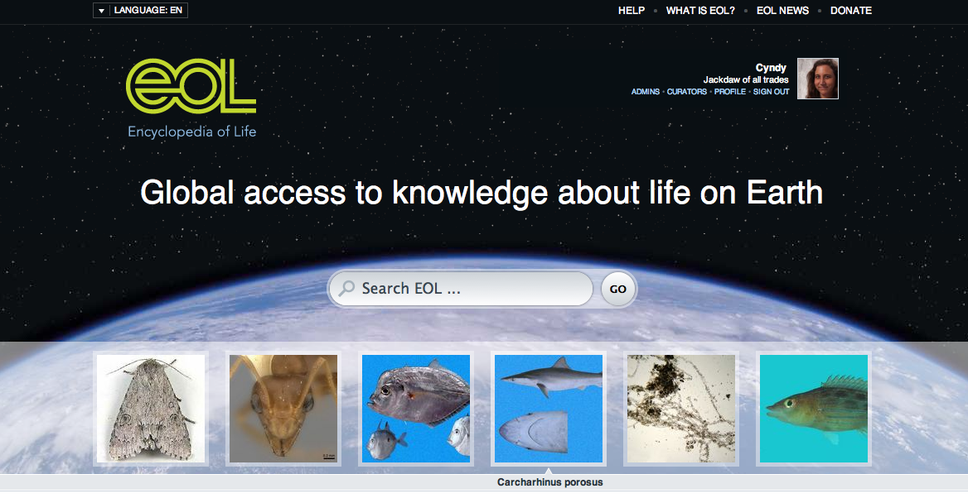
EOLv2 eol.org
Notes:
Global – the whole world
Access – free, re-usable
Knowledge – synthesized, not raw
Life on Earth – biological diversity

Slide 3
Why?
Notes:
In fact, recent assessments by the International Union for the conservation of Nature indicate that, for example, nearly 25% of mammals and one-third of amphibians are endangered or threatened [3].
Yet as much as 90% of the needs of the world’s poorest people depend directly on biodiversity for food, fuel, medicine, etc. [1] [2].

Slide 4
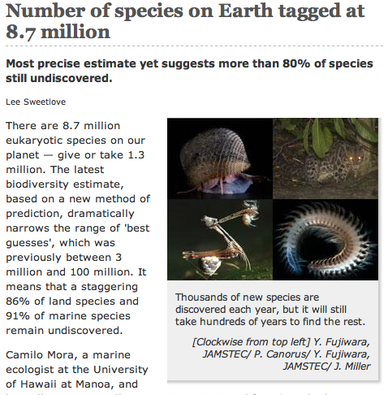
Mora et al. 2011. PLoS ONE.
Notes:
Nature news, a couple of weeks ago

Slide 5
Notes:
Part of the problem is that as we are losing biodiversity we are also losing the scientists trained to study it. An article earlier this year called it another mass extinction. Society hasn’t been creating jobs for scientists like me.

Slide 6
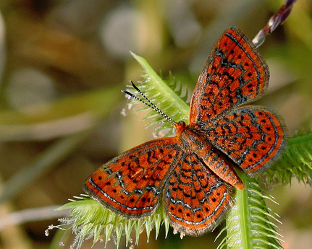
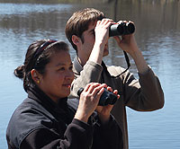
Crowd-sourcing
Photo: Mary Keim
NA Butterfly Association
Fourth of July Count
Photo: Cornell Univ.
Audubon Christmas Bird Count
Notes:
For this reason, we are increasingly turning to citizen science.
These are a few well-known citizen science projects. They encourage people to report sightings of individual organisms. Can they help to gather together all the knowledge of every species on the planet?
What about sites like Wikipedia? They allow anybody to CREATE the kind of descriptions you might want to read on the internet. But scientists haven’t jumped on board the Wikipedia bandwagon because they don’t get much credit and their work is too easily undone.

Slide 7
eol.org
EOL v1
EOL v2
Notes:
Our development of EOLv2 is following this path – in version one we developed the core ability to aggregate and curate data. In version 2 we are ensuring that people are engaged and have good reasons to work with EOL.

Slide 8
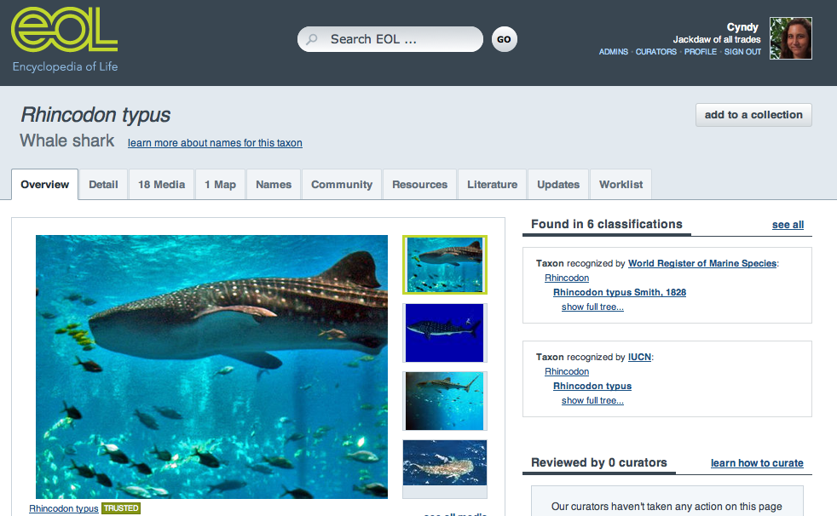
EOL aggregates and curates:
a content curation community
Scientific Databases
Scientific Journals
Curate
Aggregate
Comment
Rate
eol.org
Notes:
Instead, EOL is taking a different approach. It is an example of a new breed of website. We’ve coined the term “content curation community” to describe it.
EOL is a giant mashup that merges information that were created elsewhere on its pages which are then available for curators (mostly credentialed scientists) to trust or untrust and rate, or for anybody to provide comments or tags.
We’re partnering with over a hundred scientific databases as well as public conribution sites like Flickr and Wikipedia.
100+ partner databases 700 curators/1000s contributors/46,000 members
2.8 million pages 500 thousand pages with Creative Commons content
Over 2 million data objects and >1 million pages with links to research literature
Traffic in past year: 1.7 million unique users, 6.2 million page views

Slide 9
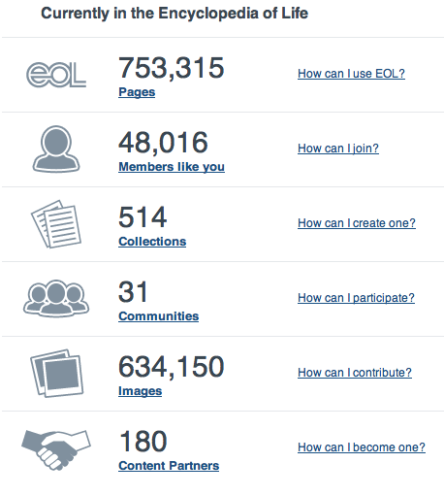
Scope
All species
Global
Many audiences
enthusiasts
learners
citizen scientists
scientists
Notes:
Milions of pages with a name at least, more than 2 million data objects distributed on those pages, including over 600,000 images

Slide 10
Community challenges
Mostly in English
So much content, hard to make sense of it
Need incentives to come back
Need to empower everyone

Slide 11
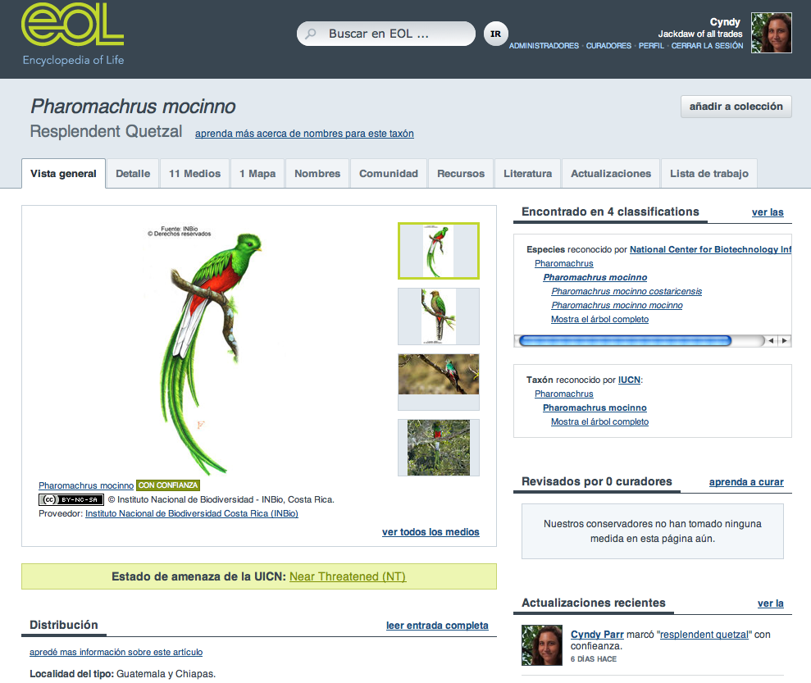

Slide 12
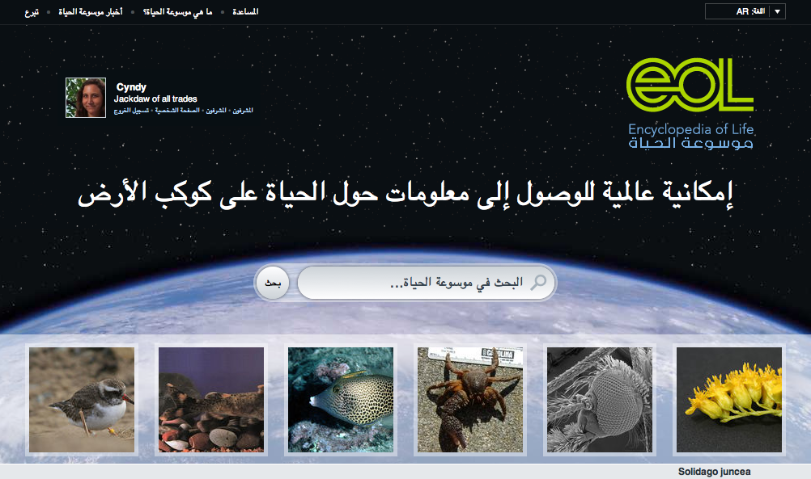
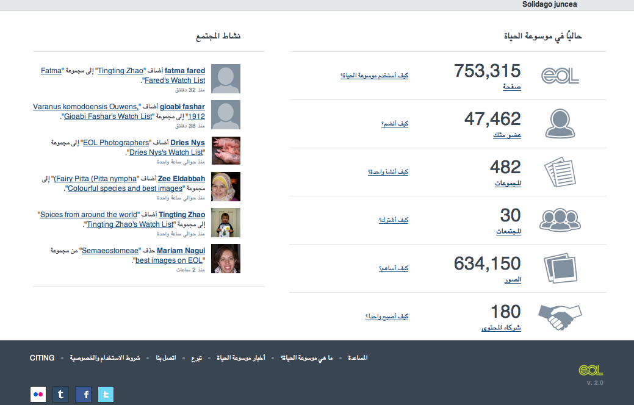
Internationalizing
Notes:
With the assistance of Biblioteca Alexandrina

Slide 14
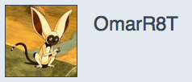
Personalizing
Notes:
Not necessary to use your real name.

Slide 15
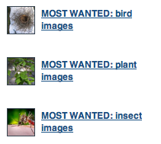
Collections can be practical
Notes:
Collections might be practical, like helping people learn more about the foods that we eat, like posting lists of wanted things, like this list of microorganisms found by Jessica Green in the air ducts of office buildings.

Slide 16
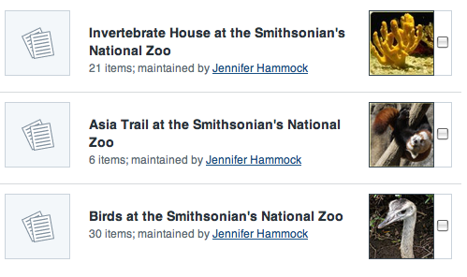
A collection of collections: Species in different areas of the National Zoo
http://www.eol.org/collections/64
Notes:
Or a Zoo might bring together the pages for species in their own facility – instead of taking months to build their own website they can create collections on EOL and point their own website visitors to EOL. Or they can pull this information and reuse it for their website.
Note that others can copy these collections into their own collections by ticking the box…

Slide 17
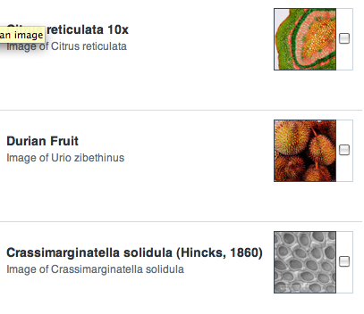
Fascinating textures: a scavenger hunt
http://www.eol.org/collections/740
Notes:
Other collections, like “Fascinating textures” might just support people to browse and find content that catches their eye.

Slide 18
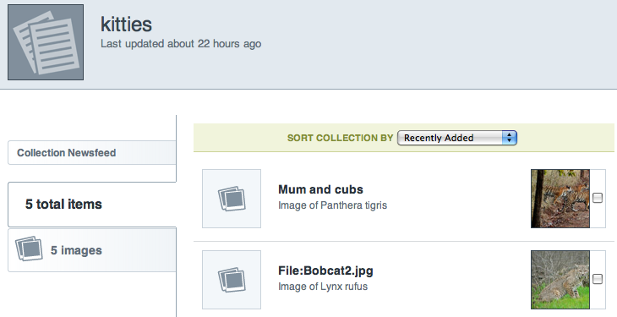
Notes:
It wouldn’t be the internet without kittens.
Placing the information in a context that has meaning for the user.

Slide 19
Communities to share interests … or to share work
Notes:
Some communities are groups of people in the same geographic location. Some communities have a purpose – people interested in mlultilingual content can help find it and develop more content in their languages. Others may have a common biological group of interest.
We’re hoping that communities will feel empowered to find and improve the content that is of interest to them. Thus expanding curation or quality control is an important feature to

Slide 20
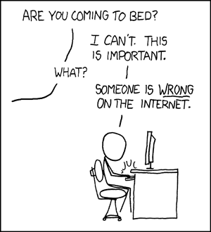
Why Curate?
http://xkcd.com/386/
Notes:
How many of you have seen this XKCD comic?

Slide 21
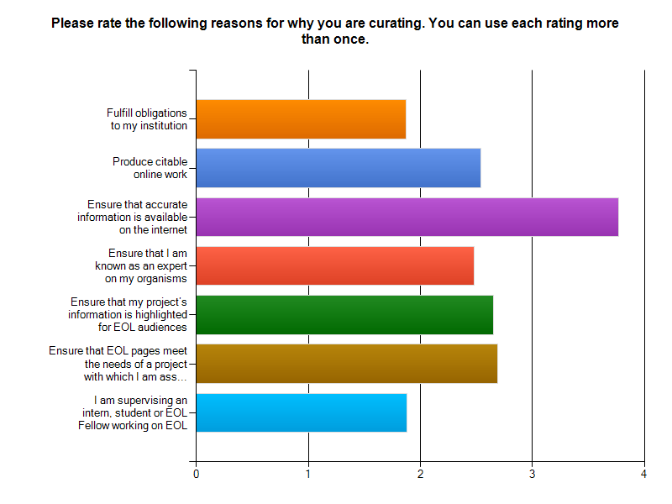
Why scientists want to curate EOL
Institutional obligations
Citable online work
Accurate info on internet
Advertise my expertise
Highlight my research
Meet needs of my project
Supervising someone else
n=161
Least important
Most important
Notes:
Why are scientists motivated to curate EOL? Here we show the average response across all respondents on a scale of least important to most important
Note the the most popular reason is to make sure there is accurate information on the internet. That’s good news because it is probably a shared motivation of both scientists and non-scientists. You’ll hear more from Dana about Altruism like this.
The rest of the highly ranked reasons all have to do with the scientist’s own work, citable work online, being known as as expert, motives about their own projects their own research. This is what Dana will talk about being Egoism.

Slide 22
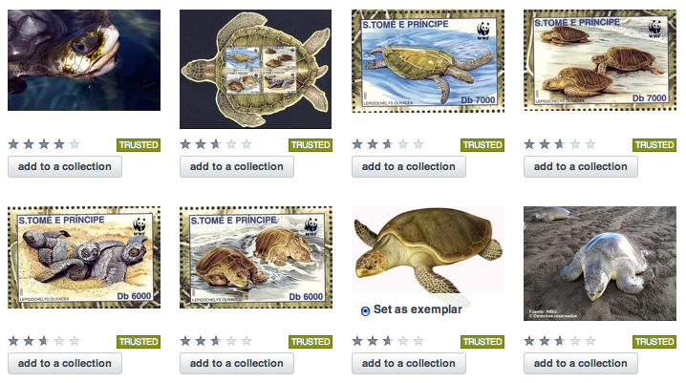
Empowering curation
Notes:
Curators can assess for trustworthiness, these happen to all be trusted. Curators have to have specific credentials.
We’ve opened up rating so that everyone can rate
We’ve created a new category of Assistant curator. Credentials here are not necessary, just real names and a lot of enthusiasm. One of the things that curators are doing is establishing their reputation by setting exemplar images, by adding common names, by recommending good articles, by finding content that may be untrustworthy, and by adding new content to fill gaps.
Following Shneiderman and Preece’s Reader to Leader framework, we hope to encourage people to get more and more invovled and eventually move into the ranks of curators

Slide 23
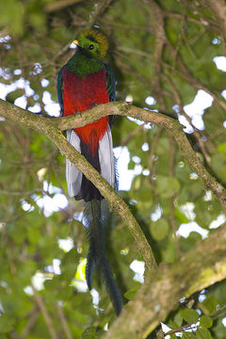
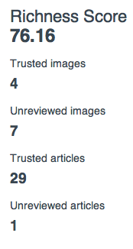
Incentives for improvement
Image credit: Peter Förster

Slide 24
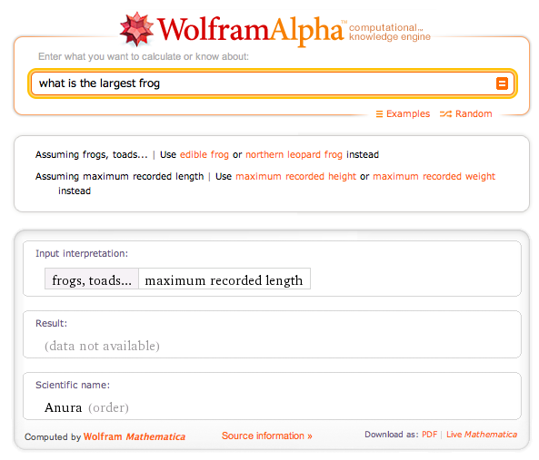
What next?

Slide 25
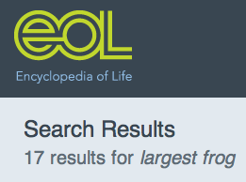
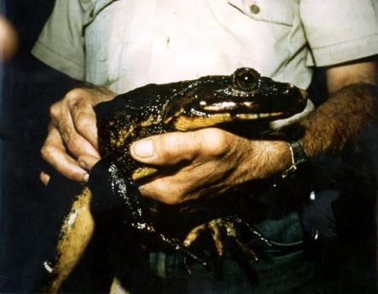
… but can’t yet be sure
EOL knows the answer
Photo credit: Breda Zimkus

Slide 26
eol.org
EOL v1
EOL v2
EOL v3?
Notes:
Our development of EOLv2 is following this path – in version one we developed the core ability to aggregate and curate data. In version 2 we are ensuring that

Slide 27
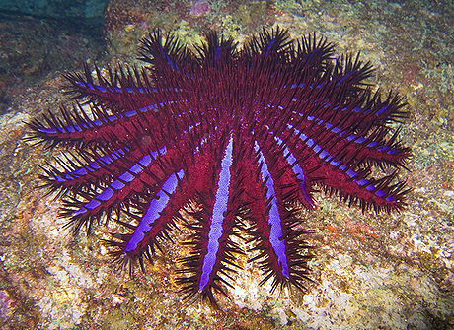
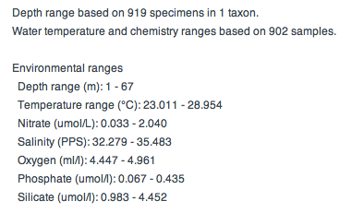
Supplier: Ocean Biogeographic Information System
http://eol.org/pages/598484/details
Notes:
For this and for 95,000 other organisms we have summarized data from one of our partners. We have the ability not only to summarize across multiple sources of numeric information, but also to provide a lot of eyes on the data to resolve conflicts and clean the data.

Slide 28
Acknowledgements
Funding from:
John D. and Catherine T. MacArthur Foundation
Alfred P. Sloane Foundation
Smithsonian Institution
Marine Biological Laboratory
and other funders and donors
All our content partners and global partners, especially:
INBio -- Costa Rica
Biblioteca Alexandrina -- Egypt
CONABIO – Mexico
OBIS – Ocean Biogeographic Information System
Volunteer curators and individual contributors via Flickr, Wikimedia, and members of EOL

